Slide 1

ASTHMA CARE & numeracy skills: are the two Aligned?
Tekyra Miles, senior Manual High School
RAwZAE gunn senior manual high school
Lucy Roberts, RN, MS, CNL, AC-E

Slide 2


Numeracy in our daily lives

Slide 3

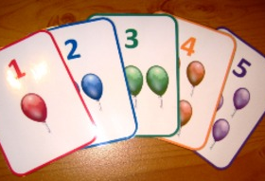
Numbers throughout our lifetime
This Photo by Unknown Author is licensed under CC BY-NC-ND

Slide 4
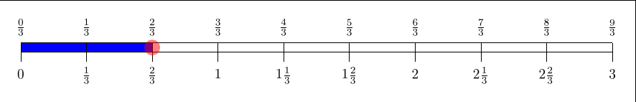
Number lines
This Photo by Unknown Author is licensed under CC BY-SA

Slide 5
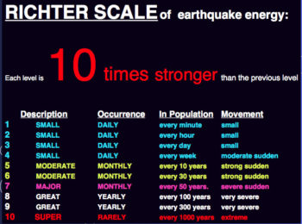
SCALEs
This Photo by Unknown Author is licensed under CC BY

Slide 6
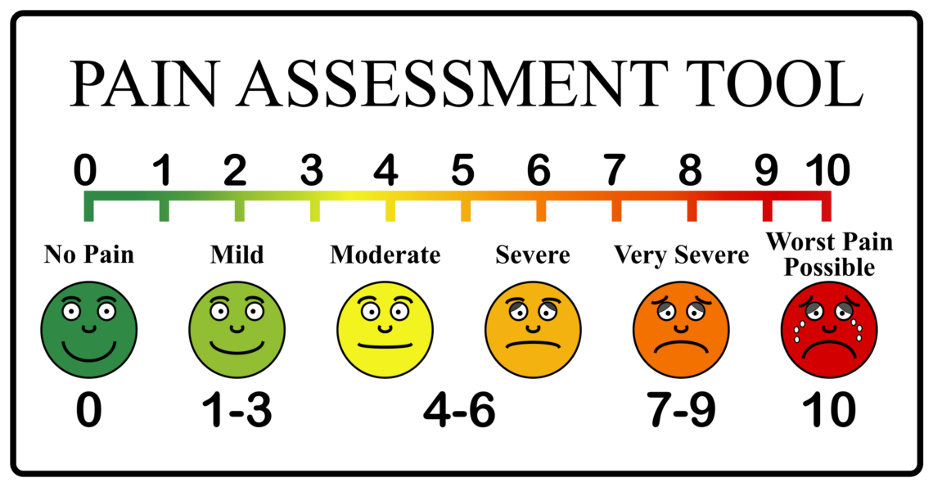
Medical assessments

Slide 7

This Photo by Unknown Author is licensed under CC BY-SA

Slide 8
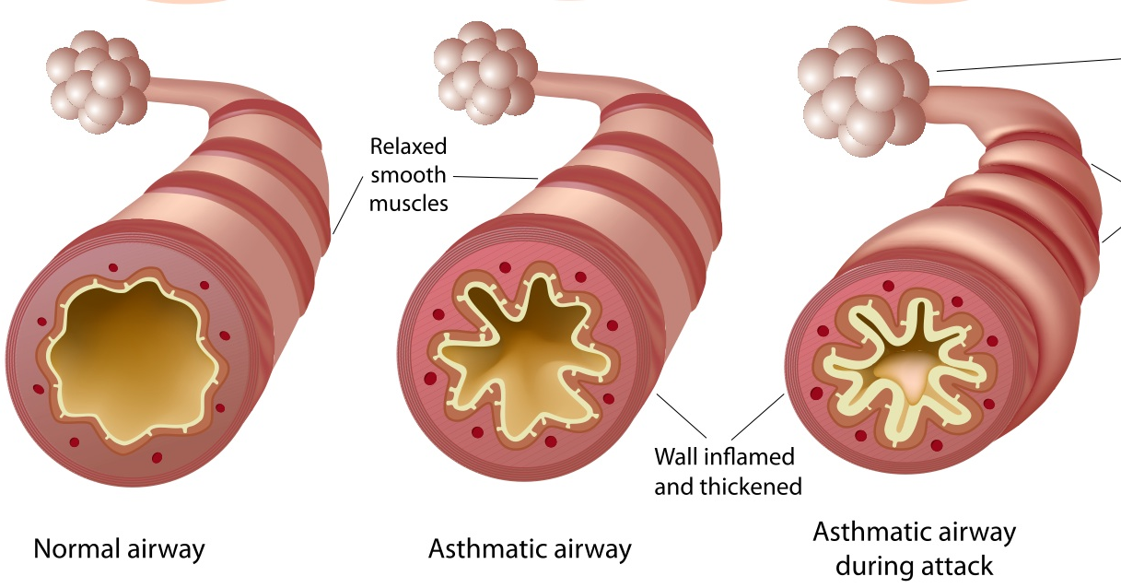
This Photo by Unknown Author is licensed under CC BY-SA-NC

Slide 9
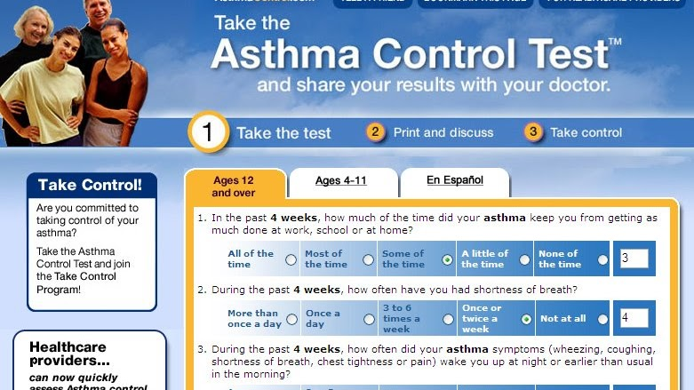
This Photo by Unknown Author is licensed under CC BY-NC-ND

Slide 10
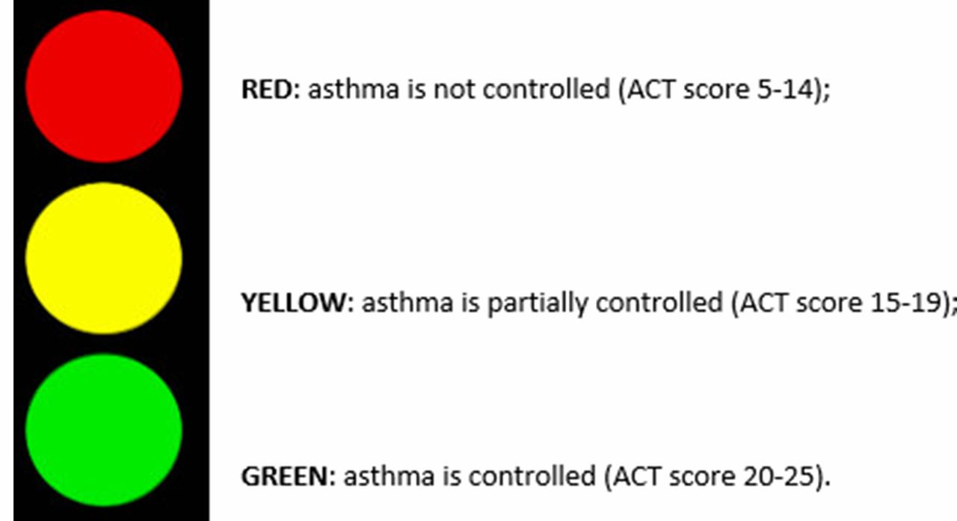
This Photo by Unknown Author is licensed under CC BY
This Photo by Unknown Author is licensed under CC BY

Slide 11
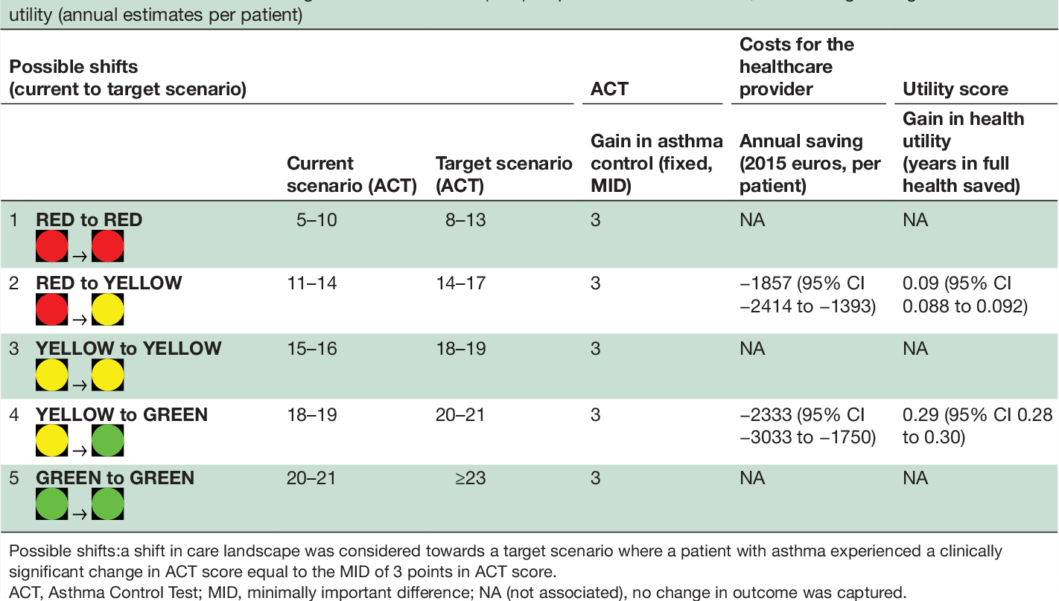

Slide 12
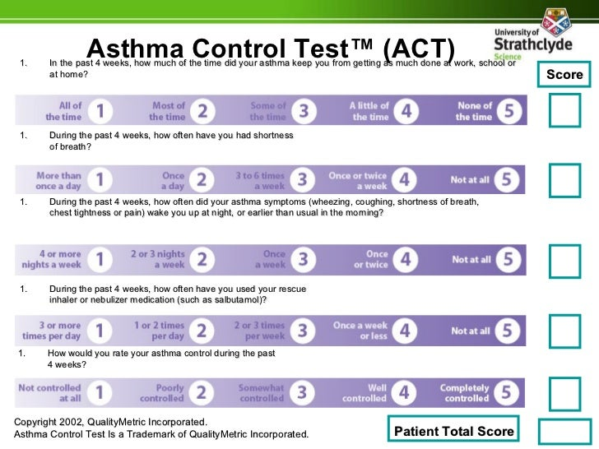
A CLOSER LOOK
AcT numeracy
1st: what do you see that is misaligned?

Slide 13


what do you see that is misaligned?

Slide 14
AcT numeracy
2nd: what do you see that is inconsistent?

Slide 15

what do you see that is misaligned?

Slide 16
AcT numeracy
3rd: what do you see that shows different descriptions to quantify?

Slide 17
what do you see that is misaligned?

Slide 18
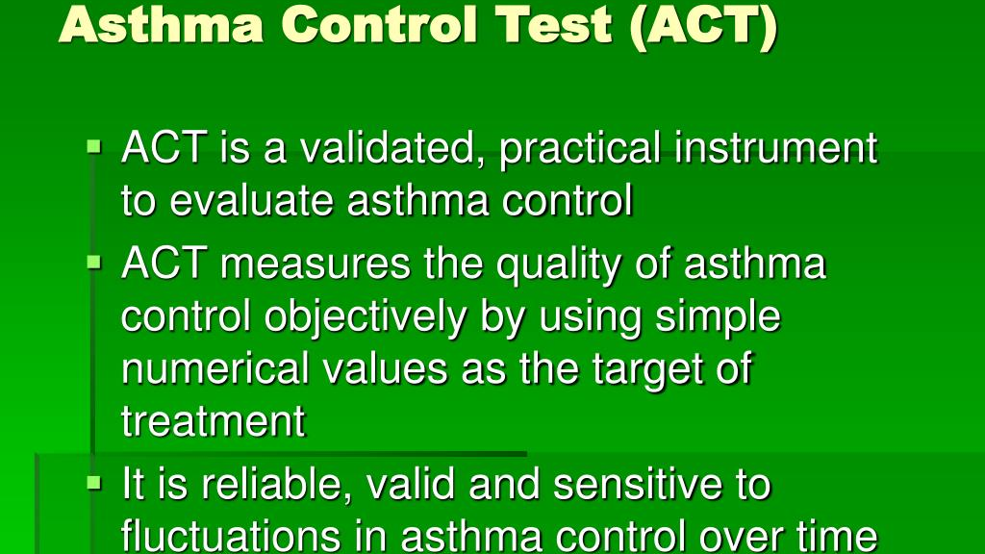

Slide 19


Slide 20
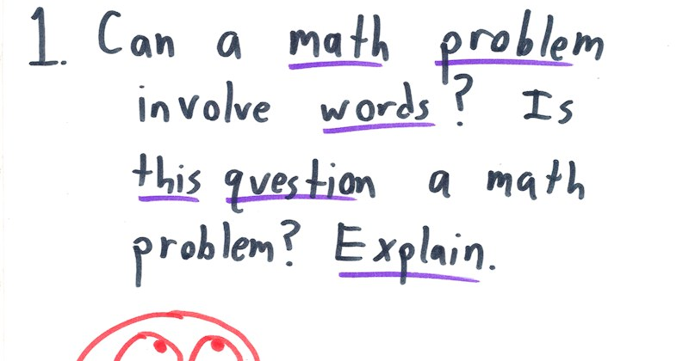
This Photo by Unknown Author is licensed under CC BY-NC

Slide 21


