Slide 1
Medicaid & Child Health Plan Plus
Kelly Kropf
Senior Manager, Navigation
Benefits in Action

Slide 2
Agenda
Benefits in Action
Medicaid and Child Health Plan Plus (CHP+)
What is MAGI Medicaid Vs. Non-MAGI Medicaid
Eligibility Overview
Application Process
Barriers and Solutions
Referrals
Getting Involved

Slide 3
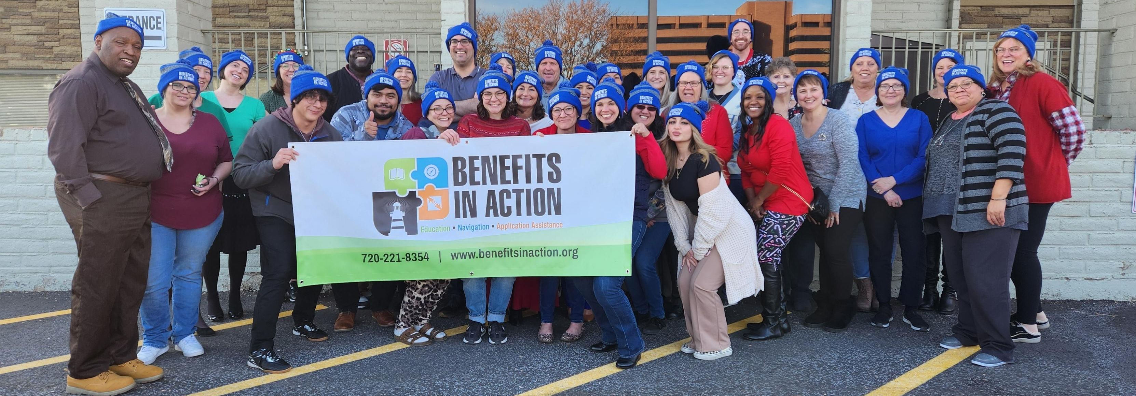
Benefits in Action is a nonprofit organization dedicated to connecting our diverse community with the support and resources they need to thrive.
MISSION:

Slide 4

HIPAA Compliance
We are a HIPAA compliant organization. All staff and volunteers must attend and pass HIPAA training annually and conform to the HIPAA rules and regulations.

Slide 5

What We Do
Benefit Literacy, Understanding, and Utilization

Slide 6
Navigation & Application Assistance
  Health
  Medicaid, waivers, Medicare, Supplements, Appeals, Savings Programs
  Connect for Health Colorado
  Social Security (SSI/SSDI, retirement)
  Financial Assistance
  Heating Assistance
  Cash Assistance Programs (AND, OAP, TANF)
  RTD LiVE (discounted RTD access)
  Food
  SNAP food assistance
  Food deliveries (Denver metro)
  Pantry referrals
  Mental Wellness
  Connectedness
  More coming soon!

Slide 7
Medicaid & Child Health Plan Plus (CHP+)
Colorado’s Medicaid Program or Health First Colorado is a public health assistance program for children and adults who meet certain eligibility criteria.
Child Health Plan Plus (CHP+) is low-cost health insurance for pregnant people and children who earn too much to qualify for Medicaid, but not enough to pay for private health insurance.
https://hcpf.colorado.gov/programs-adults
https://hcpf.colorado.gov/chp

Slide 8
What is MAGI Medicaid
Modified Adjusted Gross Income
Health Insurance
  Dental
  Vision
  Primary Care
  Behavioral Health/SUD treatment
  Pharmacy
Based on Household Income
  MAGI household=people on the same tax return
Does not look at resources or expenses
Ages 0-64 years old
Annual recertification

Slide 9
What is MAGI Medicaid
MAGI Medicaid
Non-MAGI Medicaid
Income under 133% FPL
Under the age of 65
Unqualified non-citizens facing emergency medical situations
Qualified Legal Permanent Residents*
Citizens
Income limits vary by program
Resource limit varies
Age 65+
blind, and/or disabled by SSA standards

Slide 10

What is MAGI Medicaid
MAGI Categories VS
Non-MAGI Categories
MAGI Medicaid Categories
Parent and Caretaker Relatives
Pregnant Women
Adults
Children
CHP+
Family Planning
*information from Denver Human Services Navigator Training

Slide 11
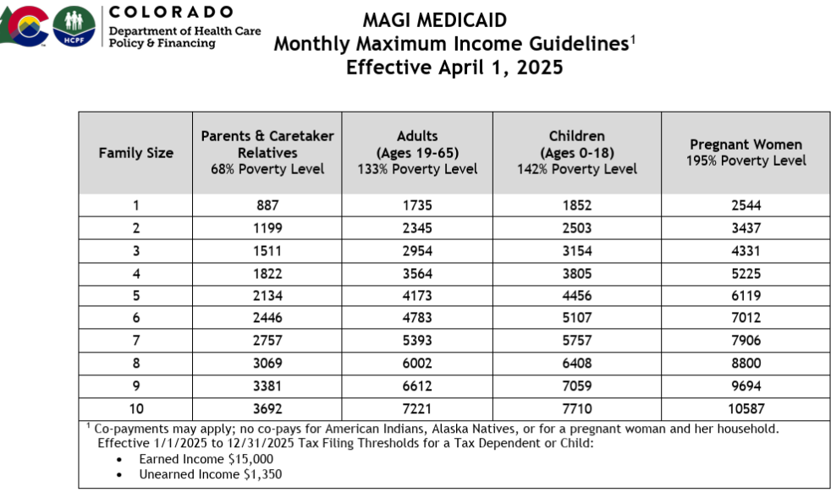

Slide 12
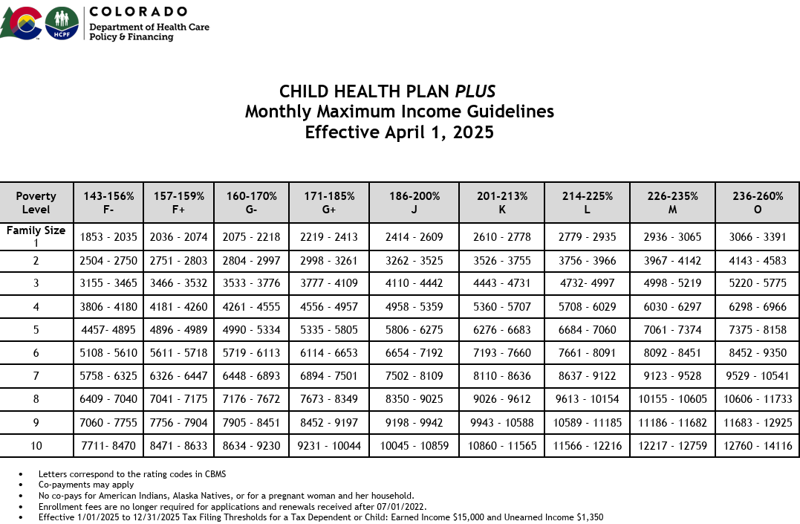

Slide 13
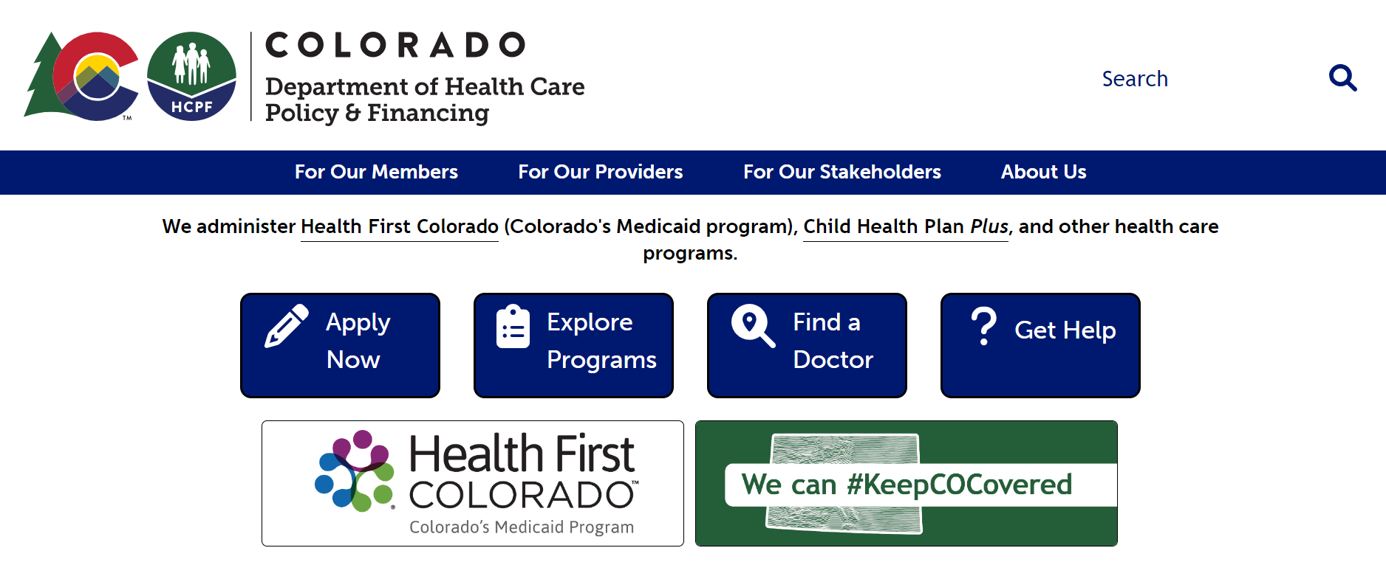
https://hcpf.colorado.gov/

Slide 14
Application Process
Medicaid applications can be submitted;
  In Person
    Walk into a Benefits in Action location, https://www.benefitsinaction.org/co-locations
  By phone
    Benefits in Action, 720-221-8354*
    Medicaid, 1-800-221-3943
  Online
    using the PEAK website, Colorado.gov/PEAK

Slide 15
Application Process
MAGI Medicaid applications can take 0-45 days to process, sometimes the client gets approved immediately
  If a client gets approved immediately, it can take up to 72 hours to show up in the provider portal
  Sometimes verification documents will be requested
    Photo ID
    Social Security Card
    Birth Certificate
    Proof of income
Non-MAGI Medicaid applications can take 90 days or longer to process

Slide 16
Barriers
Solutions
Computer systems and humans sometimes make mistakes when processing applications or verification documents
Access to transportation/internet/technology to submit applications
Communication difficulties between client and Medicaid/Human Services due to changes in phone number/address/email
Limited/misinformation about available programs and potential eligibility
Not knowing who to reach out to for help/the help doesn’t answer the phone/long wait times
What else???
Advocating for and empowering our clients
Collaboration and partnership between human services, community organizations and other entities
Community outreach efforts and referrals to organizations like Benefits in Action to assist in reporting changes in communication preferences and contact information
Fact checking, credible sources of information, ask lots of questions
Benefits in Action has worked diligently to answer the phone and serve clients as soon as possible through walk-ins, telephone or referrals to organizations with a similar mission.
What else???

Slide 17
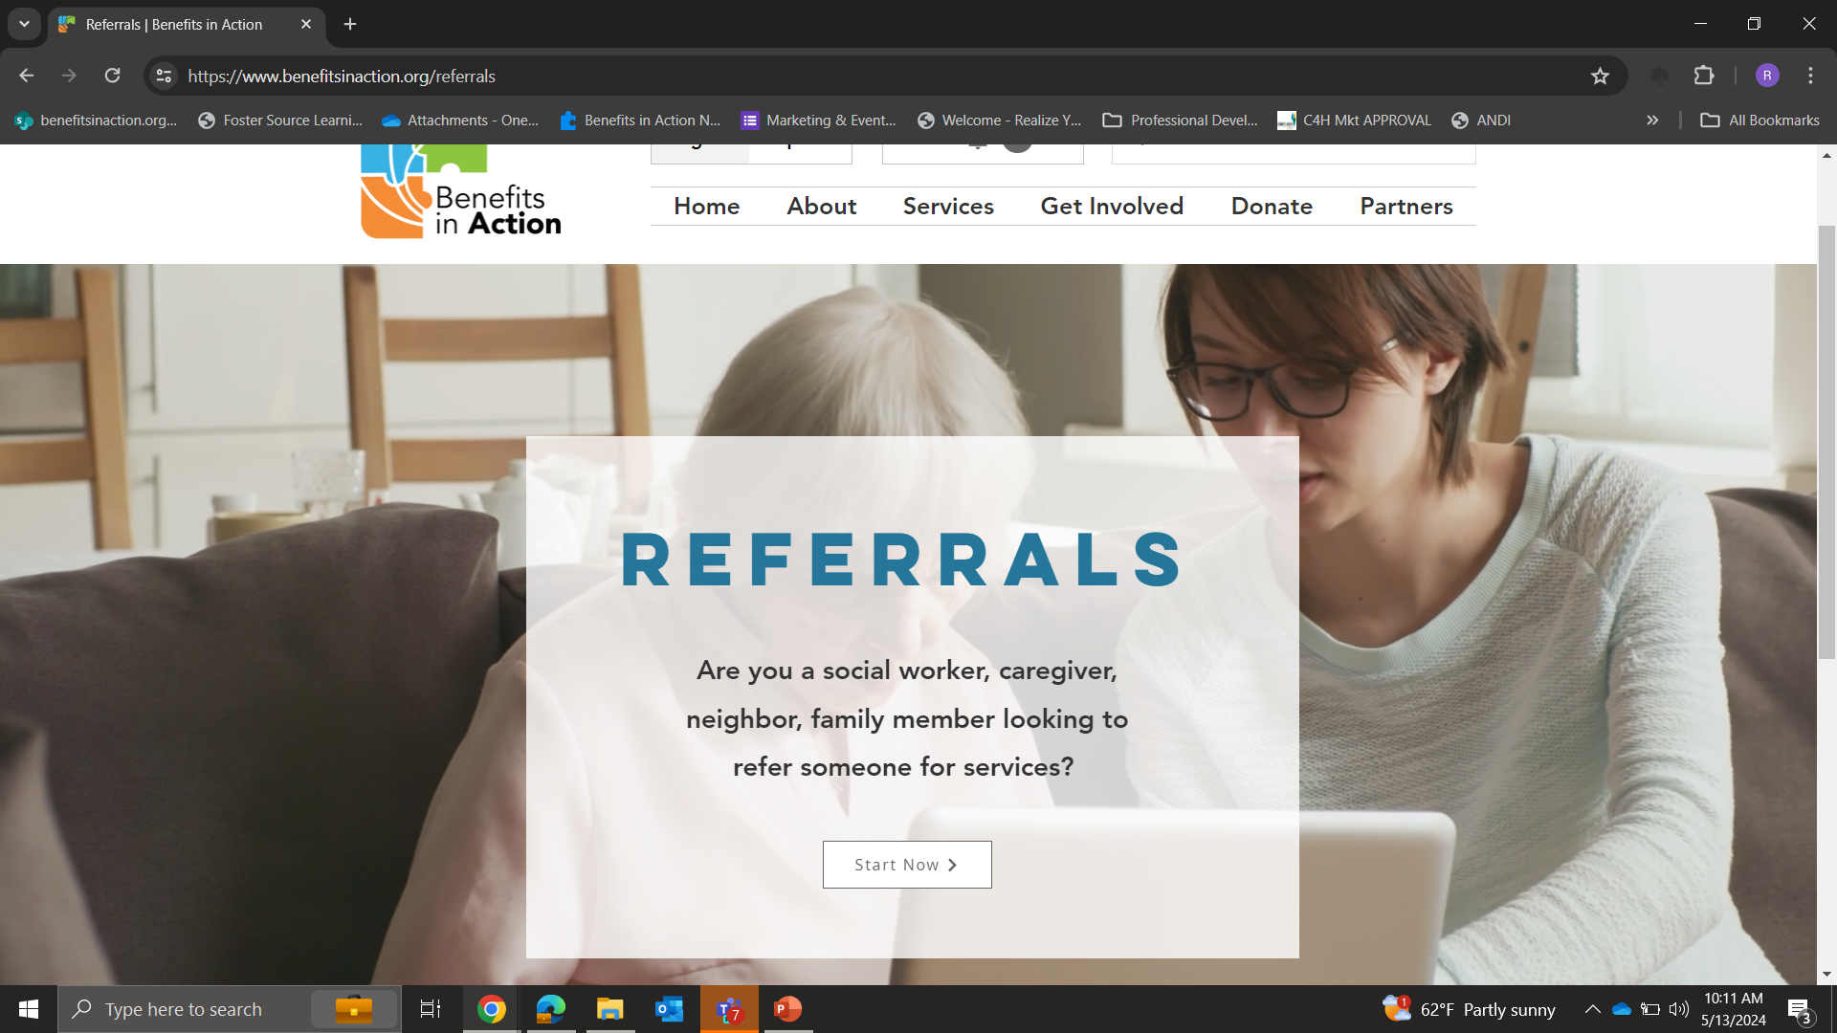

Slide 18
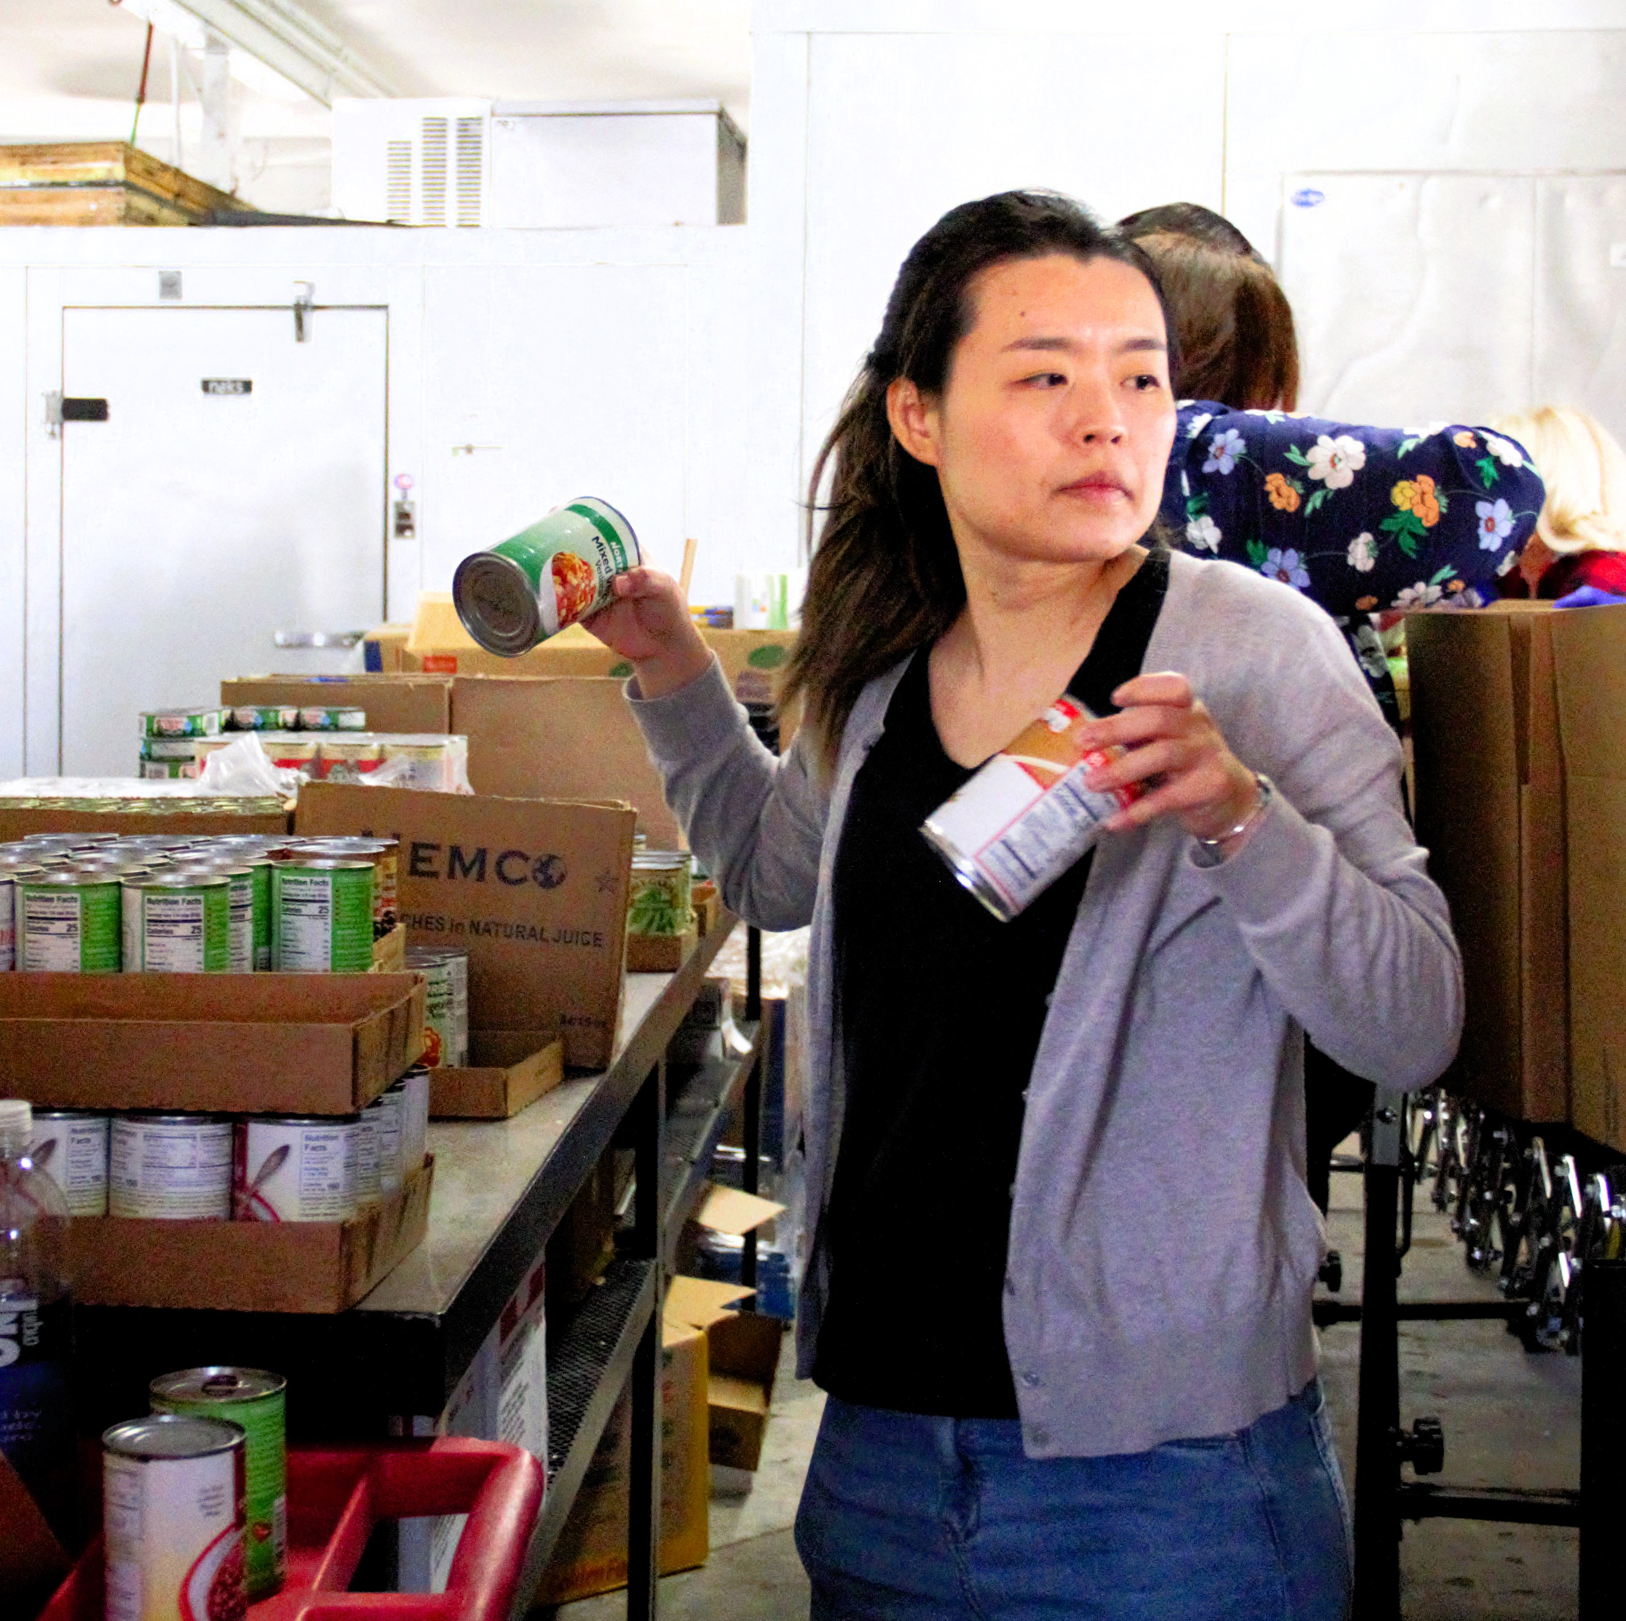
Volunteers
Food Packing​
Benefits Navigation​
Connectedness Calling​
Marketing & Outreach​
Administrative
Data Entry​
Food Delivery ​

Slide 19

Questions
Questions

Slide 20



Slide 21



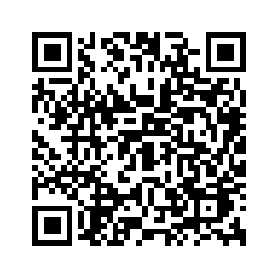
Thank you!
Kelly Kropf
kkropf@benefitsinaction.org
Intake team:
Office: 720-221-8354
info@benefitsinaction.org
www.benefitsinaction.org/referrals
www.benefitsinaction.org/food
www.bit.ly/BenefitsBeacon
Connect with us:
@benefitsinaction
@benefitsinaction
Benefits in Action

