Slide 1
3 Questions to Think About
EVERY Time We Give a Patient Numbers
Brian J. Zikmund-Fisher, PhD
Department of Health Behavior & Health Education
Department of Internal Medicine
Center for Bioethics & Social Sciences in Medicine
University of Michigan
Editor-in-Chief, Medical Decision Making and MDM Policy & Practice
@bzikmundfisher

Slide 2
A Few Types of Health Numbers…
Estimated probability of getting breast cancer (e.g., if BRCA-1)
CD4 count for HIV-positive patient
Reduction in cardiovascular risk from a statin
Change in Hemoglobin A1c for early-stage Type 2 diabetes patient
Risks of colonoscopy shared during informed consent
Risks and benefits of adjuvant therapies (e.g., post-BCS)
Risk tradeoffs in stem cell transplants (e.g., myelodysplastic syndrome)

Slide 3
So…
Why are we giving them numbers?

Slide 4
“To make sure they comprehend…”
“To inform people about…”
“To help them know…”

Slide 5
Meaning WHAT, exactly?
Ok…

Slide 6
3 Questions to Remember
What outcome are you trying to accomplish?
Are the numbers what they need?
Are the numbers contextualized?

Slide 7
3 Questions to Remember
What outcome are you trying to accomplish?
Are the numbers what they need?
Are the numbers contextualized?

Slide 8
What does it mean to understand the risk…?

Slide 9
Understanding Risk Means What?
Risk Concept | Illustrative Risk Messages
Possibility | “It could happen to me.”
Relative / Comparative Possibility | “It is more likely to happen to me.” “I am more likely to have this happen to me than to have that happen to me.”
Categorical Possibility | “I am a person who has a high chance of this happening.”
Relative Probability | “I have a risk that is higher to this degree.”
Absolute Probability | “My risk is this.”
Comparative Probability | “My (group’s) risk is this, which is higher than another’s (group’s) risk.” “My risk is this if I do X, which is higher than my risk if I do Y which is that.”
Incremental Probability | “My risk will change that much if I do this.”
Zikmund-Fisher BJ. The right tool is what they need, not what we have: A taxonomy of appropriate precision in patient risk communication. Medical Care Research & Review, 2013

Slide 10
BUT:
We care about more than just “understanding”…

Slide 11

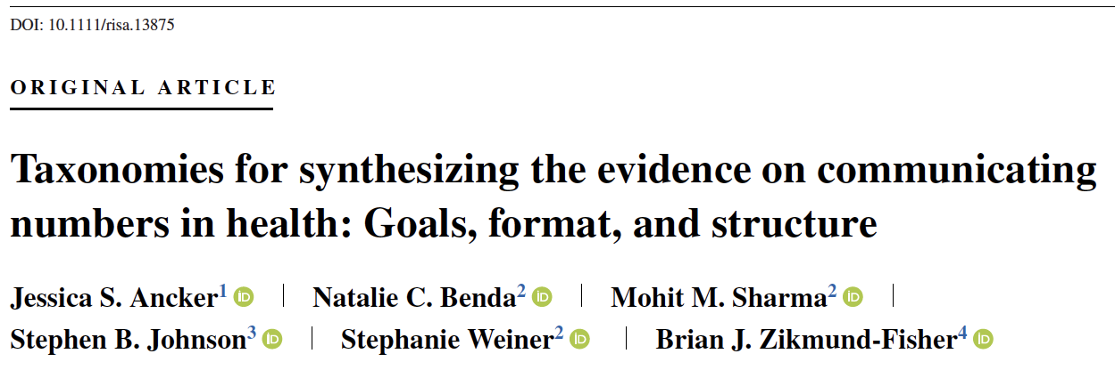
Apples vs. Oranges in Number Communication

Slide 12
A Taxonomy of Number Communication Outcomes
COMPREHENSION
Identify
Recall
Dominant
Framework
Compute
Ancker JS, Benda NC … Zikmund-Fisher BJ. Taxonomies for synthesizing the evidence on communicating numbers in health: Goals, format, and structure. Risk Analysis 2022

Slide 13
A Taxonomy of Number Communication Outcomes: I
Identify | Can I find the right number?
Recall | Can I remember the number?
Dominant | Can I tell which number is largest or smallest?
Framework | Can I appropriately categorize the number?
Compute | Can I do computations with the number?
Ancker JS, Benda NC … Zikmund-Fisher BJ. Taxonomies for synthesizing the evidence on communicating numbers in health: Goals, format, and structure. Risk Analysis 2022

Slide 14
A Taxonomy of Number Communication Outcomes
COMPREHENSION
INTERPRETATION
Identify
Recall
Dominant
Framework
Compute
Cognitive Perception
Emotional Perception
Sensitivity to Deviation
Behavioral Intentions
Behavior
Preference
Trust
Magnitude
or
Difference
Ancker JS, Benda NC … Zikmund-Fisher BJ. Taxonomies for synthesizing the evidence on communicating numbers in health: Goals, format, and structure. Risk Analysis 2022

Slide 15
A Taxonomy of Number Communication Outcomes: II
Cognitive perception | Do I see the number (or number difference) as larger or smaller?
Emotional perception | Does the number (or number difference) make me feel more or less?
Sensitivity to deviation | Do I notice when the number changes?
Behavioral intentions | Does the number make me want to do something?
Behavior | Does the number make me do something?
Preference | Do I like the number presented this way?
Trust | Do I trust the number?
Ancker JS, Benda NC … Zikmund-Fisher BJ. Taxonomies for synthesizing the evidence on communicating numbers in health: Goals, format, and structure. Risk Analysis 2022

Slide 16
Example: Cardiovascular risk calculator
I want to…
  …have people remember their likelihood of heart attack or stroke?
  …believe that the calculator provides trustworthy information?
  …know if they are at high risk?
  …have a higher perceived risk of heart attack or stroke?
  …go see their doctor or take actions if they are at high risk?

Slide 17
Example: Risk reduction from PrEP for HIV
I want to…
  …accurately remember the size of the risk reduction from using PrEP?
  …perceive PrEP to be effective at reducing risk of getting HIV?
  …be less worried about getting HIV if they use PrEP?
  …be motivated to use PrEP?

Slide 18
Example: Asthma medication information
I want to…
  …recognize whether the drug increases or decreases my chance of a particular condition?
  …calculate how big of a risk reduction the drug causes?
  …perceive the medication to be effective at reducing asthma symptoms?
  …recognize that the medication decreases some risks but increases other ones?
  …be motivated to choose this medication over another one?

Slide 19
You Can’t Have It All!
(No, really… you can’t…)

Slide 20
Pick ONE

Slide 21
3 Questions to Remember
What outcome are you trying to accomplish?
Are the numbers what they need?
Are the numbers contextualized?

Slide 22
What your audience needs
to do
What a number communication can actually
do
The Sweet Spot!

Slide 23
The Making Numbers Meaningful Project
Goal:
To create an evidence-based, online guide for health communicators to recommend formats for presenting numerical information in health and medicine
National Library of Medicine R01 LM012964
Notes:
JSA

Slide 24
The Making Numbers Meaningful Team
Research team
Jessica Ancker (PI, Vanderbilt)
Brian Zikmund-Fisher (Co-I, Michigan)
Nat Benda (Co-I, Weill Cornell)
Stephen B Johnson (Co-I, NYU)
Mohit Sharma (Coordinator, Weill Cornell)
Andrew Liu (MPH Student, Michigan)
Michelle Demetres (librarian, Weill Cornell)
Diana Delgado (librarian, Weill Cornell)
Expert panel
Cynthia Baur, UMD
Sara Czaja, Weill Cornell
Angie Fagerlin, Utah
Carolyn Petersen, Mayo
Rima Rudd, Harvard
Michael Wolf, Northwestern
Steven Woloshin, Dartmouth
Notes:
JSA

Slide 25
Data Types
1 number:
  Probability vs. Quantity
Many of 1 type of number
Differences between numbers
  Pre-calculated (e.g., relative risk reduction)
  Available to be calculated
Special cases:
  Time-trends
  Tradeoffs
Ancker JS, Benda NC … Zikmund-Fisher BJ. Taxonomies for synthesizing the evidence on communicating numbers in health: Goals, format, and structure. Risk Analysis 2022

Slide 26
Possible Format Comparisons
Numbers vs numbers
Numbers vs. verbal probabilities
Numbers vs. graphics
Graphics vs. graphics
Denominator manipulations
Animations or interactivity
Context manipulations
Uncertainty
Framing
Timeframe manipulations
Ancker JS, Benda NC … Zikmund-Fisher BJ. Taxonomies for synthesizing the evidence on communicating numbers in health: Goals, format, and structure. Risk Analysis 2022
Notes:
BZF

Slide 27
Many Outcomes
COMPREHENSION
INTERPRETATION
Identify
Recall
Dominant
Framework
Compute
Cognitive Perception
Emotional Perception
Sensitivity to Deviation
Behavioral Intentions
Behavior
Preference
Trust
Magnitude
or
Difference
Ancker JS, Benda NC … Zikmund-Fisher BJ. Taxonomies for synthesizing the evidence on communicating numbers in health: Goals, format, and structure. Risk Analysis 2022

Slide 28
Organizing the Review Around Tasks
Task-Driven Research Questions:
Do Stimulus A and Stimulus B (each showing the same data) generate similar or different outcomes when participants perform the same task on both?
NOTE: Stimuli may support more than 1 type of task
Stimulus A
Outcomes
Stimulus B
Task
Data
Task
Data
Data presentation format A
Data presentation format B
Notes:
JSA

Slide 29
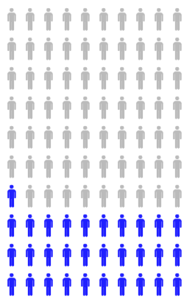
E.g., …
Stimulus
Outcome
Task
Data
Data presentation format
Stimulus contains some data presented in some numerical or graphical format
3. Research participant conducts cognitive task on stimulus
2. Researcher presents outcome questions to participant
Examines proportion to answer the question
“How common is this side effect?”
“How worried would you be about this side effect?”
Notes:
JSA

Slide 30
Massive Scope
Reviewed >20,000 titles
  Experiments and quasi-experiments comparing 2 or more formats for presenting health-related numbers
  Measured quantitative outcomes related to behavior, comprehension, perceptions, or attitudes
  Adult, lay participants
  No time or language limits
Identified 408 articles about how to communicate:
    Numerical risks
    Laboratory results
    Patient-reported outcomes
    Environmental data
Conducted standardized risk-of-bias evaluation
Conducted standardized data extraction/summarization
892 distinct findings about probability communication alone
… and more to come
Notes:
JSA (BZF next)

Slide 31
Forthcoming Outcomes of the Making Numbers Matter Project
8-12 papers in process
  Methods / scoping review
  6+ papers on probability communication evidence
  3+ papers on quantity communications evidence
  Integrative review paper
  Reporting standards
Communicating Numbers Clearly online tool
  Designed to help communicators identify the evidence relevant to their data and objective

Slide 32
Did You Know?
Telling someone that a side effect is “rare” makes them more worried than if you told them it happens in 1% of cases?
  In fact, on average, they interpret “rare” to mean about 9%!

Slide 33
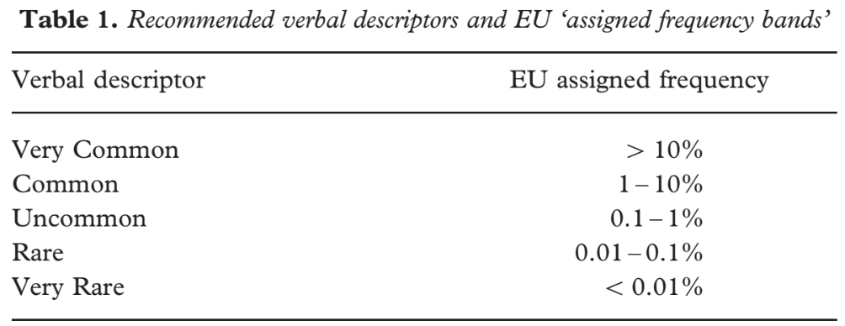
Verbal Descriptors of Probability
  10 high-credibility studies of the EC verbal risk descriptors tended to find that perceived probability and/or negative emotion was higher with verbal descriptors than with the corresponding probability numbers (%, 1 in X, or common-denominator rates).
Berry, Raynor, & Knapp., Psychology, Health & Medicine, 2003

Slide 34
Did You Know?
If you say there’s a 1 in 100 chance, most people perceive this as bigger than a 1% chance?

Slide 35
A Simple (?) Question
Which of the following numbers represents the biggest risk of getting a disease?
  1 in 100
  1 in 1000
  1 in 10
20% of a college-educated US sample got this wrong
Lipkus IM, Samsa G, Rimer BK. General performance on a numeracy scale among highly educated samples. Medical Decision Making. 2001.

Slide 36
Grimes and Snively, 1999
Which risk is bigger:
1 in 384 or 1 in 112?
Which risk is bigger:
2.6 per 1000, or 8.9 per 1000?
56% of women chose the correct answer
73% of women chose the correct answer
Grimes, D. A. and G. R. Snively (1999). "Patients' understanding of medical risks: Implications for genetic counseling." Obstetrics and Gynecology 93: 910-914.

Slide 37
Avoid Using 1-in-X Formats (…Unless Being Persuasive)
Using 1-in-X (vs. rates out of 100 / 1000) increases perceived risk
  22 RCTs: 11 significant effects, 3 similar effects, 8 no effect, 0 reverse direction
Using 1-in-X (vs. rates out of 100 / 1000) decreases ability to identify larger or smaller risks
  4 RCTs: 2 significant effects, 2 no effect, 0 reverse direction
Using 1-in-X (vs. rates out of 100 / 1000) decreases ability to perform computations
  6 RCTs: 3 significant effects, 3 no effect, 0 reverse direction
Unpublished review data, JS Ancker & BJ Zikmund-Fisher, 2022

Slide 38
Just say No to 1-in-X
“The traditional use of proportions [e.g., 1 in 384 vs. 1 in 112], to express risk in genetic counseling lacks scientific basis.”
    Grimes & Snively, 1999, Obstetrics and Gynecology
“If a clinician intentionally prescribes a medication or surgical therapy known to cause harm when an alternative that has proven to be both safer and more effective is clearly identified and readily available, most people will express concern about that clinician’s decision making. … Given the current state of evidence from Pighin and others, any continued use of 1-in- X formats to communicate medical risk to patients is similarly intolerable.”
    Zikmund-Fisher, 2010, Medical Decision Making

Slide 39
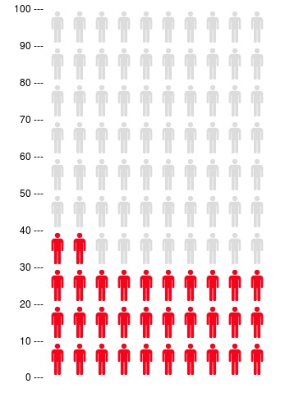
An Evidence-Supported Risk Graphic Called…
What is this called?
icon array
pictograph
pictogram
emoticons
face pictogram
bathroom figures
restroom icons
stick figures
block chart
wall of women
100 representative faces
crowd chart
crowd-figure-pictogram
Cates plot
smiley faces
smiley icons
population/crowd figures
population figures
population diagram
100 faces
frequency format
people charts
matrix of 100 elements
glyph-based representation
Paling Palettes
1000-people histogram
pictorial display
Kuiper-Marshall personographs
....

Slide 40
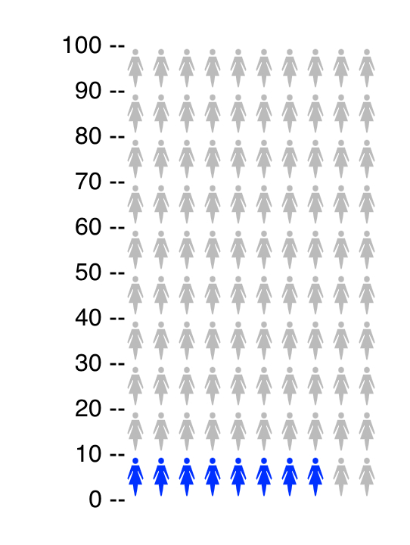
Do You Perceive these Risks the Same?
>>
8%
>
Ancker, Zikmund-Fisher, et al., unpublished manuscript

Slide 41
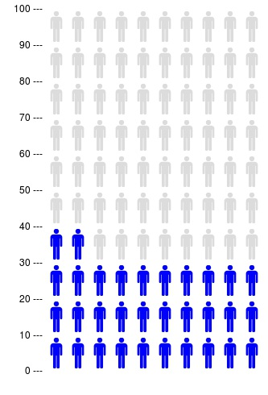
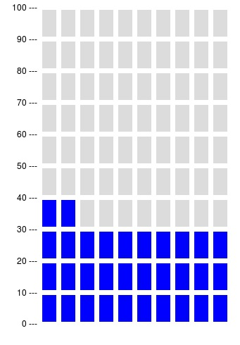
Did You Know?
People will remember 32% better if it is shown:
BUT: Icon type does NOT change perceived probability
…like this
...instead of like this
Ancker, Zikmund-Fisher, et al., unpublished manuscript

Slide 42
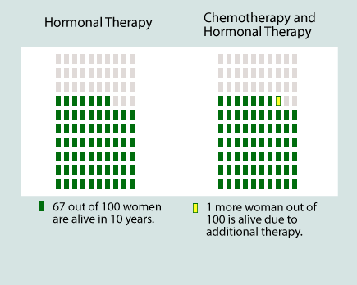
Icon Arrays Highlight Absolute Differences
Zikmund-Fisher BJ, Fagerlin A, Ubel PA, A demonstration of “less can be more” in risk graphics. Medical Decision Making, 2010.

Slide 43
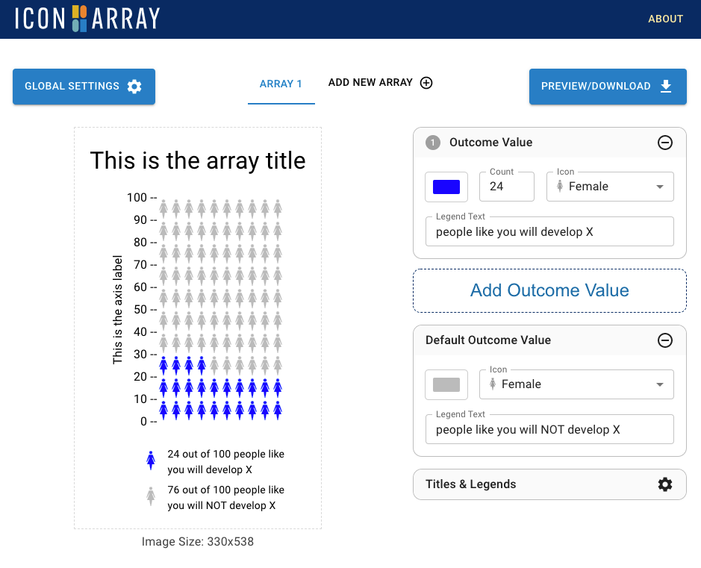
Iconarray.com
Free, online risk graphics generator
  1+ outcomes / array
  Up to 3 arrays in a set
  Customizable colors, icons, titles and legends
  Several array structures
    Incl.: 25 x 40 (1000 unit) arrays

Slide 44
3 Questions to Remember
What outcome are you trying to accomplish?
Are the numbers what they need?
Are the numbers contextualized?

Slide 45
A Story…

Slide 46
Total Bilirubin:
1.4 mg/dL

Slide 47
“Don’t worry!”
“I’ll tell you when to worry”

Slide 48
Accessible ≠ Useful

Slide 49
Can Patients Use This?

Slide 50
What Is Out of Range?

Slide 51
Can People Identify Test Results As Out-of-Range?
Type 2 diabetes scenario
  Task: To determine if Hemoglobin A1c was outside the Standard Range
1817 adults age 40-70
  Demographically diverse Internet panel
  Measured health literacy and numeracy
Zikmund-Fisher BJ, Exe NL, Witteman HO. Numeracy and literacy independently predict patients’ ability to identify out-of-range test results. Journal of Medical Internet Research 2014;16(8):e187.

Slide 52
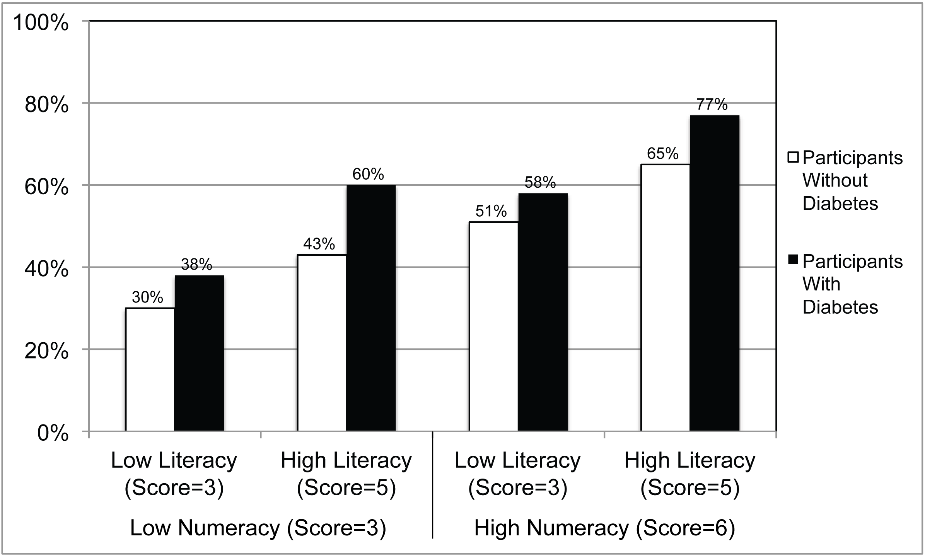
Effects of Numeracy and Literacy
Zikmund-Fisher BJ, Exe NL, Witteman HO. Numeracy and literacy independently predict patients’ ability to identify out-of-range test results. Journal of Medical Internet Research 2014;16(8):e187.

Slide 53
Information Evaluability

Slide 54
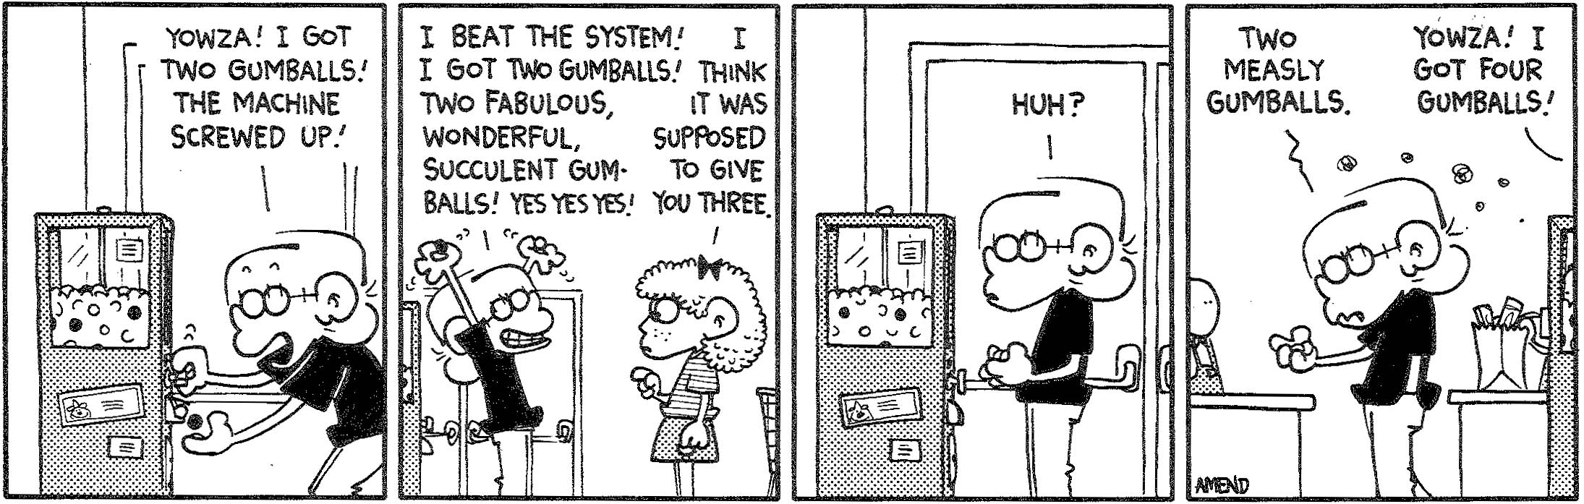
Good or bad?
Amend B. Welcome to Jasorassic Park, 1998, p.36.

Slide 55
So, what do we do?

Slide 56
KEY Q:
How do experts know what the data mean?

Slide 57
Data Characteristic Questions
What units are commonly used?
What is the direction of improvement?
What range of values is possible? Actually observed?
How much change in the value represents an important change?
Are the action thresholds or target goals or ranges?
Are there meaningful categories?
Are there norms available (e.g., average values, normal ranges)?
Are there relative position measures (e.g., percentile scores)?
Zikmund-Fisher BJ. Helping People Know Whether Measurements Have Good or Bad Implications: Increasing the Evaluability of Health and Science Data Communications. Policy Insights from the Behavioral and Brain Sciences, 2019.
Notes:
Will present these one at a time. Phased introduction needed

Slide 58
Solution:
Contextualize the data!

Slide 59
Ways to Contextualize Data
Normal/healthy references
Comparisons (absolute differences)
Action thresholds / goal ranges
Categories
Range of variation
Clinically important differences
Zikmund-Fisher BJ. Policy Insights from the Behavioral and Brain Sciences, 2019.

Slide 60
Action thresholds

Slide 61
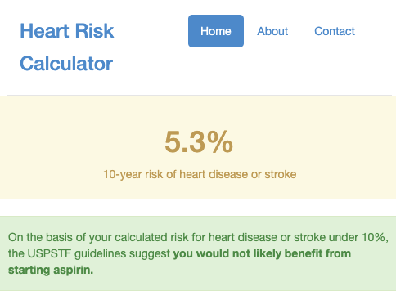
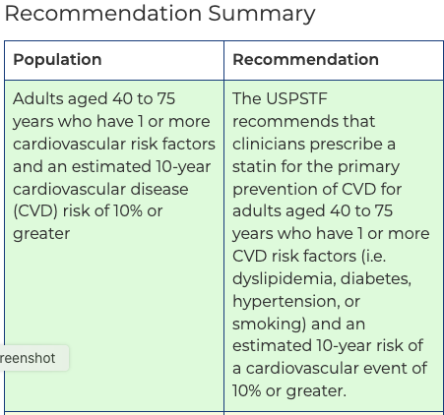
Action Thresholds
https://www.uspreventiveservicestaskforce.org/uspstf/recommendation/statin-use-in-adults-preventive-medication
https://www.cvriskcalculator.com/

Slide 62
Action Thresholds
https://www.uspreventiveservicestaskforce.org/uspstf/recommendation/statin-use-in-adults-preventive-medication
https://www.cvriskcalculator.com/

Slide 63
Range of variation & categories

Slide 64
Table
Zikmund-Fisher BJ, et al. Graphics help patients distinguish between urgent and non-urgent deviations in laboratory test results. Journal of the American Medical Informatics Association 2017;24(3):520-528.

Slide 65
Table vs. Number Line
Zikmund-Fisher BJ, et al. Graphics help patients distinguish between urgent and non-urgent deviations in laboratory test results. Journal of the American Medical Informatics Association 2017;24(3):520-528.

Slide 66
% with No Difference in Perceived Urgency
Platelets:135 vs 25 x10⁹/L
ALT: 80 vs 260 IU/L
Creatinine: 2.2 vs 3.4 mg/dl
 | Platelets (135 vs 25 x10⁹/L) | ALT (80 vs 360 IU/L) | Creatinine (2.2 vs 3.4 mg/dl)
Table | 26.5 | 56.3 | 43.7
Simple Line | 17.5 | 21.3 | 27.7
Zikmund-Fisher BJ, et al. Graphics help patients distinguish between urgent and non-urgent deviations in laboratory test results. Journal of the American Medical Informatics Association 2017;24(3):520-528.

Slide 67
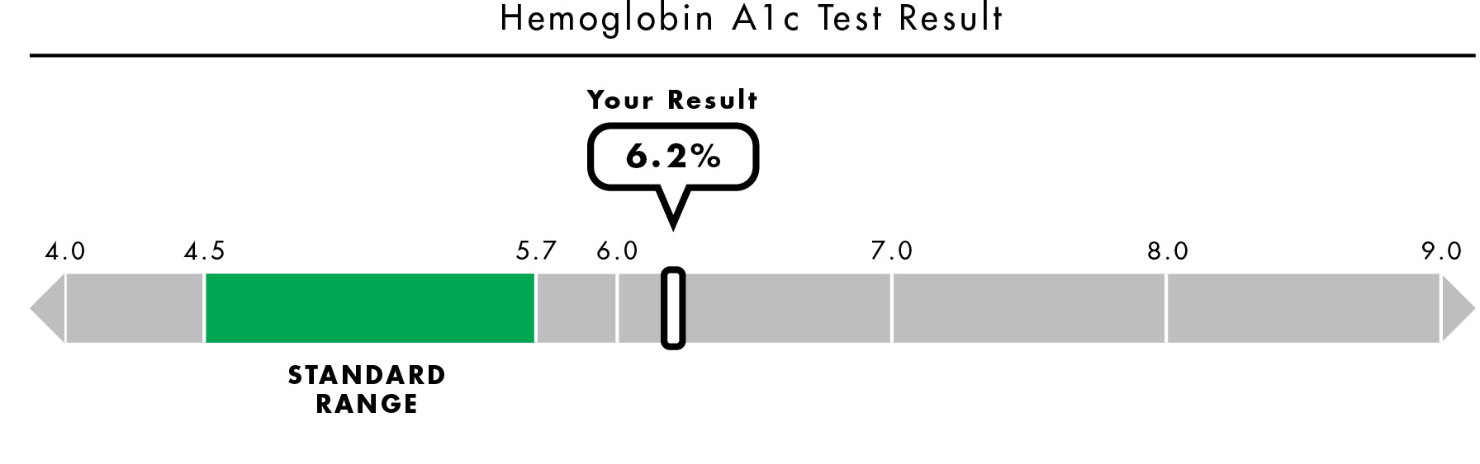
Hemoglobin A1c
Unpublished graphic from 1 R01 HS021681, BJ Zikmund-Fisher, Principal Investigator.

Slide 68
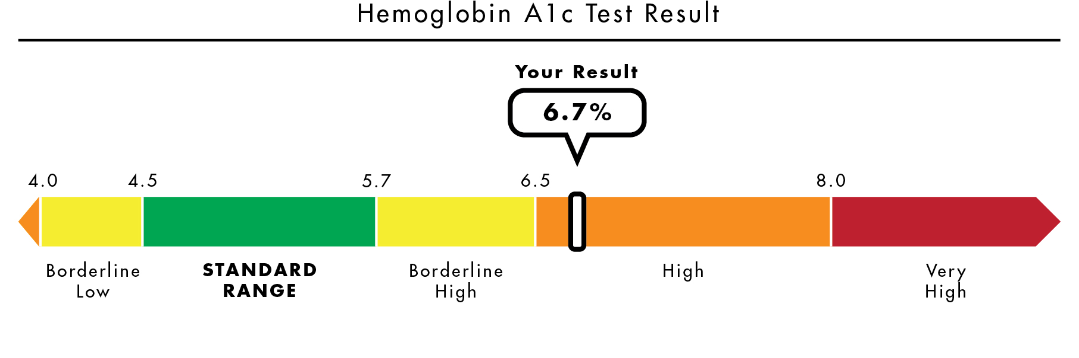
Hemoglobin A1c
Unpublished graphic from 1 R01 HS021681, BJ Zikmund-Fisher, Principal Investigator.

Slide 69
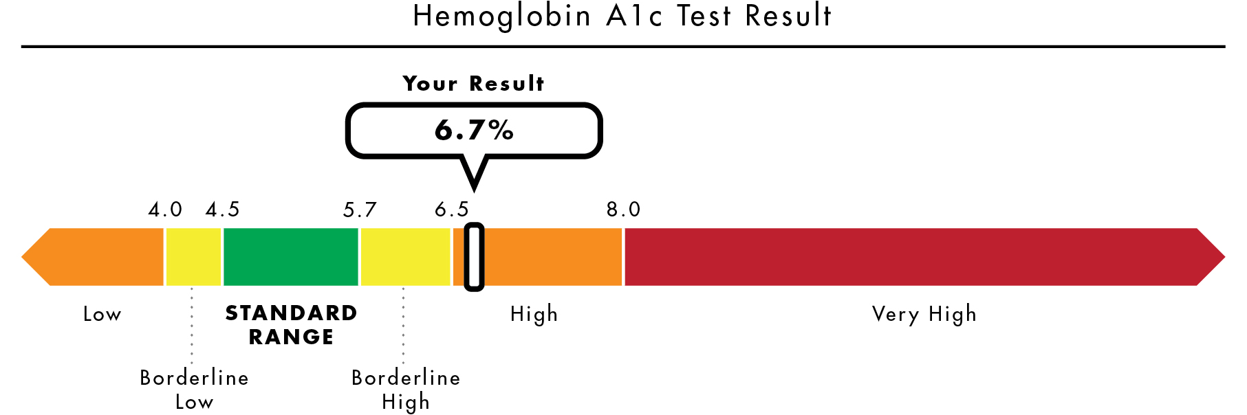
Same (?!?) Result
Unpublished graphic from 1 R01 HS021681, BJ Zikmund-Fisher, Principal Investigator.

Slide 70
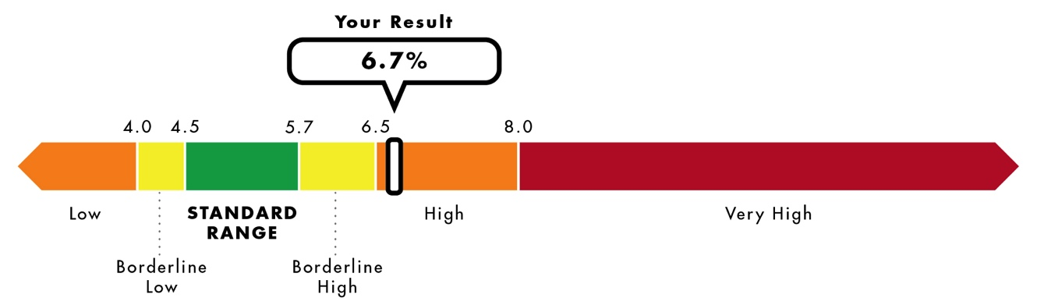
Scale Matters
Unpublished graphics from 1 R01 HS021681, BJ Zikmund-Fisher, Principal Investigator.

Slide 71
Define relevant reference points

Slide 72
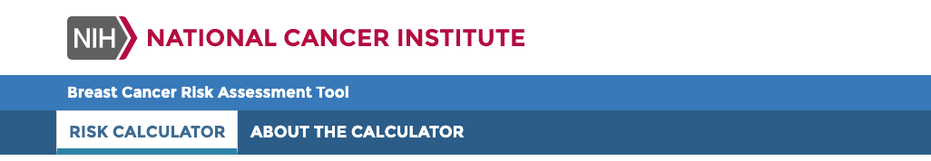
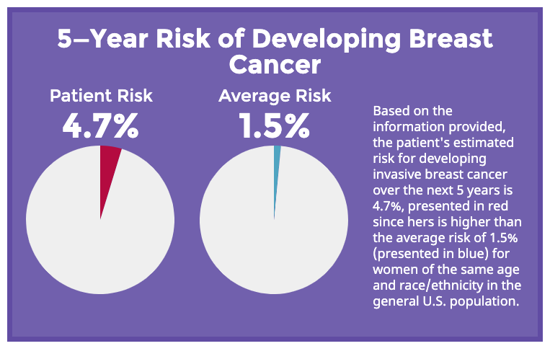
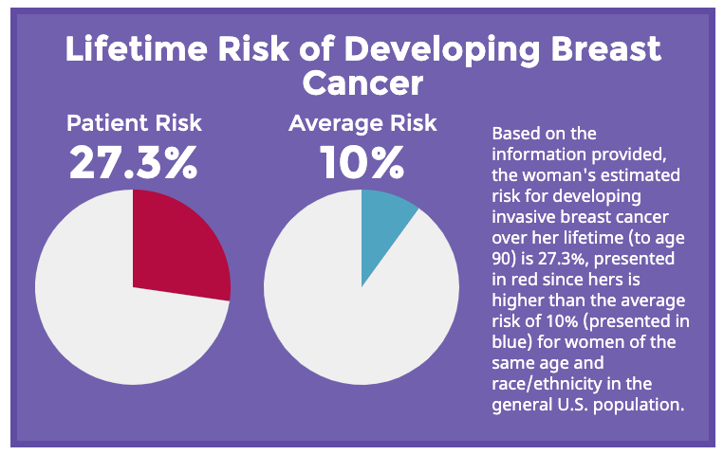
https://bcrisktool.cancer.gov/calculator.html

Slide 73
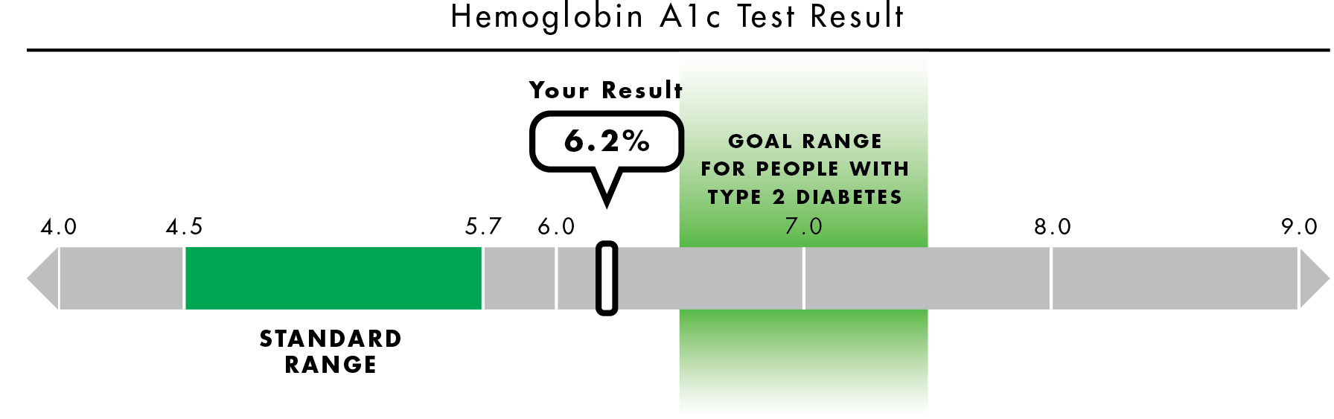
Goals for Test Results
Scherer AM, Witteman HO, Solomon J, Exe NL, Fagerlin A, Zikmund-Fisher BJ. Improving understanding of test results by substituting (not adding) goal ranges: experimental study. Journal of Medical Internet Research, 2018.

Slide 74
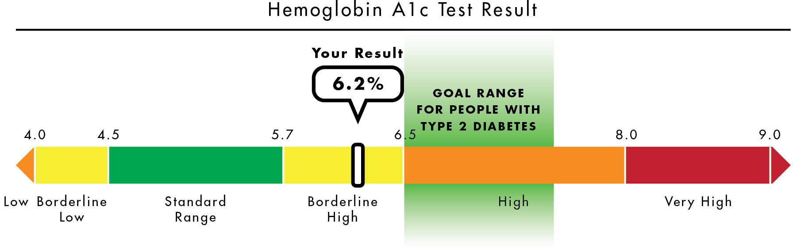
Goals for Test Results
Scherer AM, Witteman HO, Solomon J, Exe NL, Fagerlin A, Zikmund-Fisher BJ. Improving understanding of test results by substituting (not adding) goal ranges: experimental study. Journal of Medical Internet Research, 2018.

Slide 75
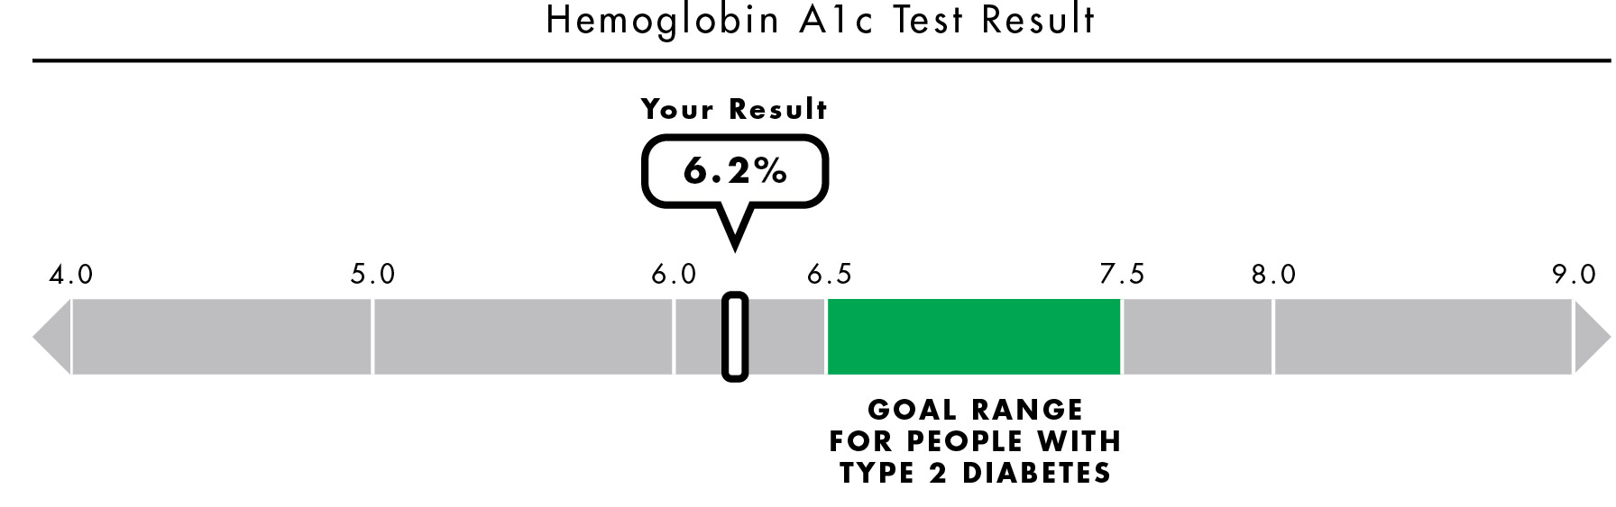
Goals for Test Results
Scherer AM, Witteman HO, Solomon J, Exe NL, Fagerlin A, Zikmund-Fisher BJ. Improving understanding of test results by substituting (not adding) goal ranges: experimental study. Journal of Medical Internet Research, 2018.

Slide 76
Harms
Alanine Aminotransferase (ALT):
80 IU/L
Standard Range: 10-40

Slide 77
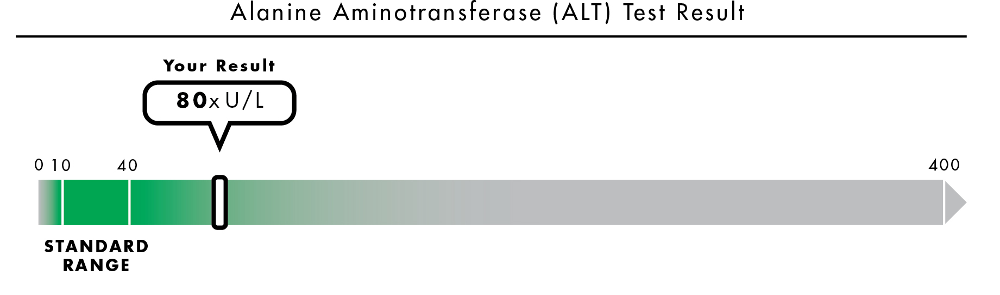
Showing the Possible Range
Zikmund-Fisher BJ, Scherer AM, Witteman HO, Solomon J, Exe NL, Fagerlin A. Providing harm anchors in visual displays of test results can mitigate patient perceptions of urgency about near-normal values. Journal of Medical Internet Research, 2018.

Slide 78
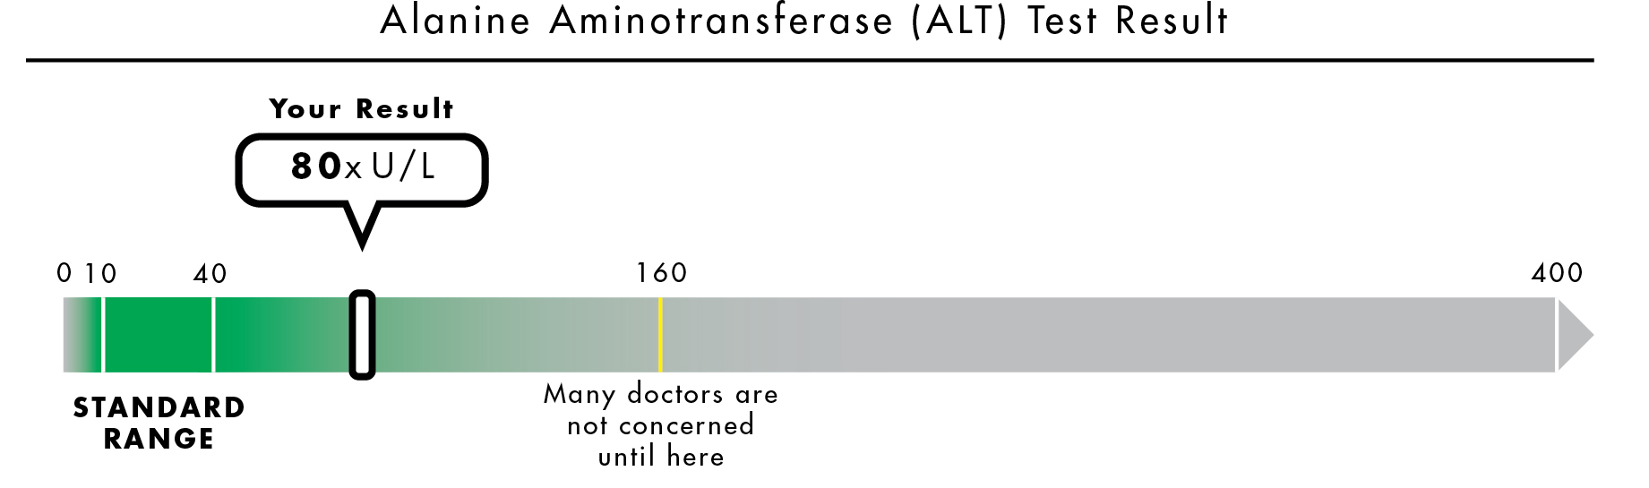
Harm Anchors
“Many doctors are not concerned until here”
Zikmund-Fisher BJ, Scherer AM, Witteman HO, Solomon J, Exe NL, Fagerlin A. Providing harm anchors in visual displays of test results can mitigate patient perceptions of urgency about near-normal values. Journal of Medical Internet Research, 2018.

Slide 79
Increased Sensitivity with Harm Anchors
Zikmund-Fisher BJ, Scherer AM, Witteman HO, Solomon J, Exe NL, Fagerlin A. Providing harm anchors in visual displays of test results can mitigate patient perceptions of urgency about near-normal values. Journal of Medical Internet Research, 2018.

Slide 80
Problem?
Avoiding bias

Slide 81
Health data communications are ALWAYS biased
… and, frankly, manipulative!

Slide 82
3 Questions to Remember
What outcome are you trying to accomplish?
Are the numbers what they need?
Are the numbers contextualized?
Thank you!
@bzikmundfisher

Slide 83
Need-Congruent Types of Risk Knowledge
Need | What Patients Care About | Congruent Types of Risk Knowledge
Avoid Surprise and Regret | Care that this could happen | Possibility
Recognize Dominant Options | Care that this is most / least | Relative / Comparative Possibility
Motivate to Act or Not Act | Care that this is good / bad | Categorical Possibility
Make Multi-Attribute Tradeoff Decisions | Care about this more than that | Comparative Possibility and/or Comparative Probability
Make Magnitude-Dependent Decisions | Care that this is X% not Y% | Precise Comparative or Incremental Probabilities
Zikmund-Fisher BJ. The right tool is what they need, not what we have: A taxonomy of appropriate precision in patient risk communication. Medical Care Research & Review, 2013

