Slide 1
What we have learned about risk: Lessons from the Cultural Navigator Program during COVID
Terry Lieber, BS, PMP and Joan M. Nelson, RN, ANP, DNP

Slide 2
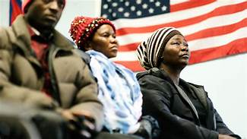
Spring Institute of Intercultural Learning
Empower people and organizations to succeed across languages and cultures
Adult Education
ESL
GED
Citizenship
Paraprofessional Development
Colorado Welcome Back
Internationally trained health care professionals gain licensure in the US

Slide 3
Spring Institute
Interpretation and Translation
Diversity and Inclusion Training and Consulting
Immigration Legal Services
Project Shine

Slide 4
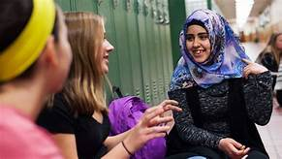
Project Shine
Health literacy training
Community engagement activities
Patient navigation services- Partnership with University of Colorado, DU
Covid Response- TriCounty and UCH
UCH Project Expansion
.

Slide 5
UCH Cultural Navigation Program
History
Somali Family
HOH diagnosed with Covid on Ventilator
Family believed hospital experimenting on patient
Bad experience triggered collaboration between Spring Institute and UCH
Goal was to navigate these situations where cultural barriers interfered with care
Discovered many barriers were related to lack of resources

Slide 6
Collaboration
Began in August 2020
Over 700 referrals
Majority of clients Spanish speaking
Languages include Sangho, Chuukese, Amharic, Tigrinya, Burmese, Nepali, Somali, Swahili, Karen, Korean, Lingala, Marshallese, French, Mandarin, Vietnamese, Oromo, Tagalog, Dari, Pashto, Arabic, Farsi, Kinyarawandan, Rohingya, Urdu, Khmer, American Sign Language

Slide 7
What is a refugee?
A refugee is defined as a person who has fled his or her home country and cannot return based upon a "well-founded fear of persecution" due to race, religion, nationality, political opinion, or membership in a social group.
Central and South Americans face challenges in being classified as refugees.
https://www.dhs.gov/sites/default/files/publications/immigration-statistics/yearbook/2018/refugees_asylees_2018.pdf

Slide 8
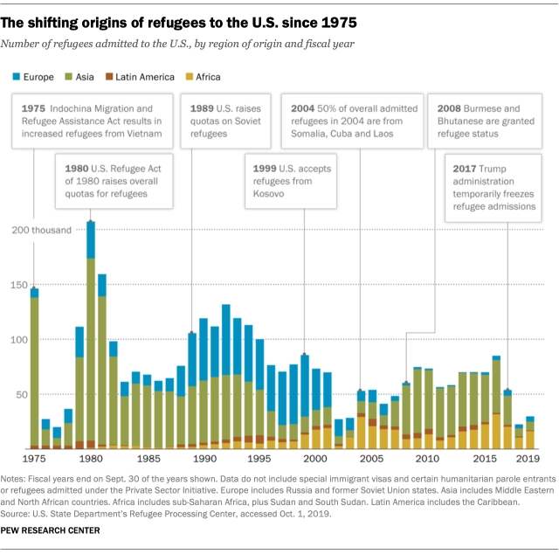

Slide 9
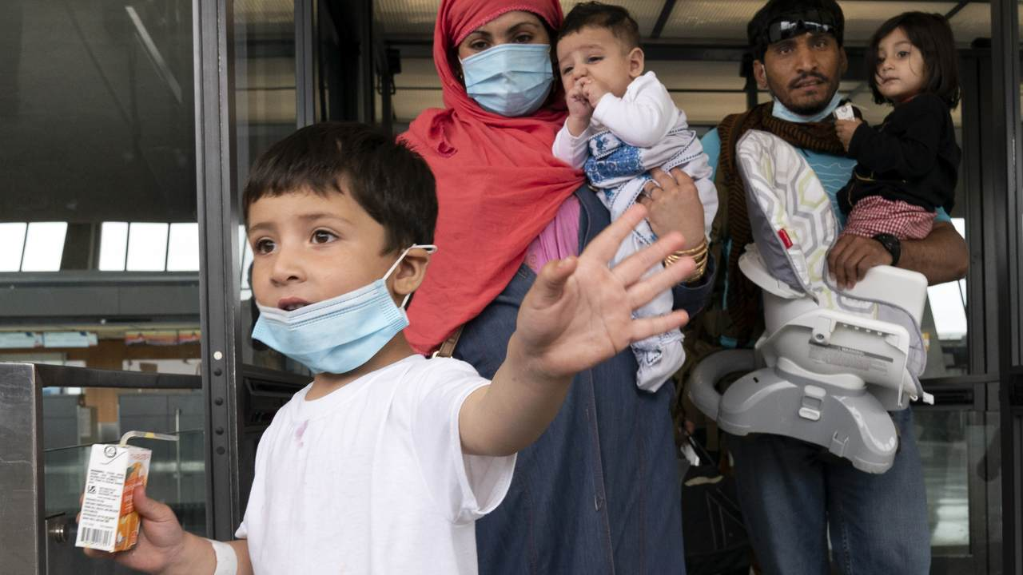
Afghan Refugees

Slide 10
Afghan Refugees
97,000 refugees in past 20 years
37,000 additional since 9/21
https://www.axios.com/afghan-refugees-each-state-data-bea47ca4-0212-4a41-98bd-a2ea9f15a5bc.html

Slide 11
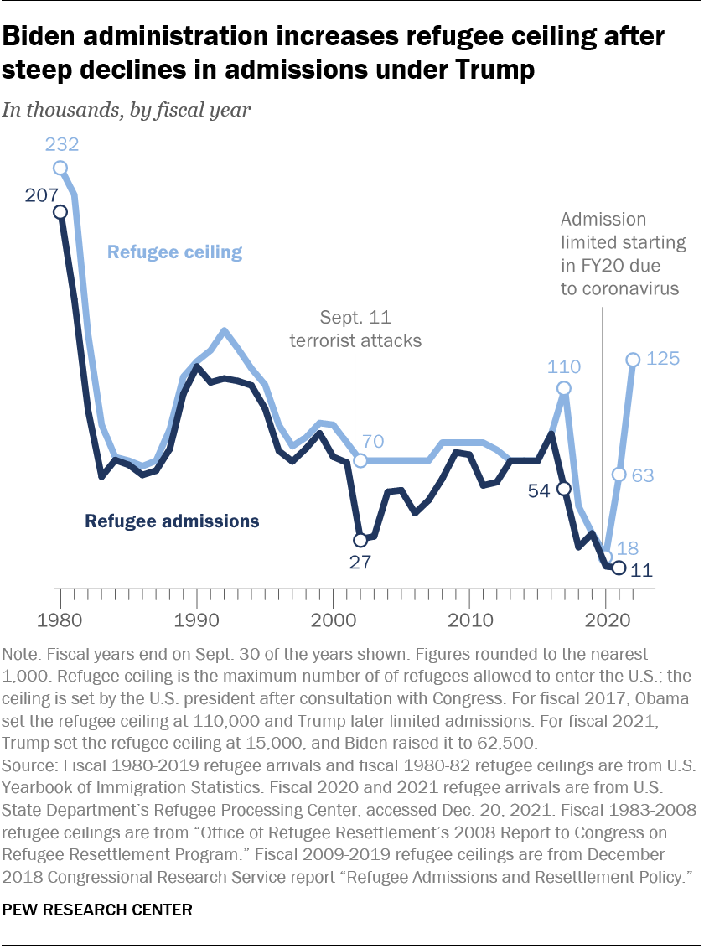

Slide 12
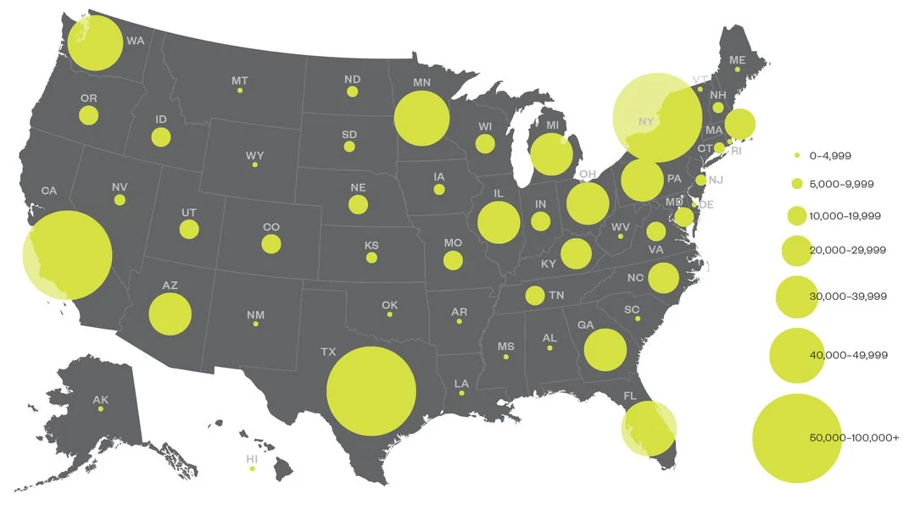
Resettlement of Refugees since 2021

Slide 13
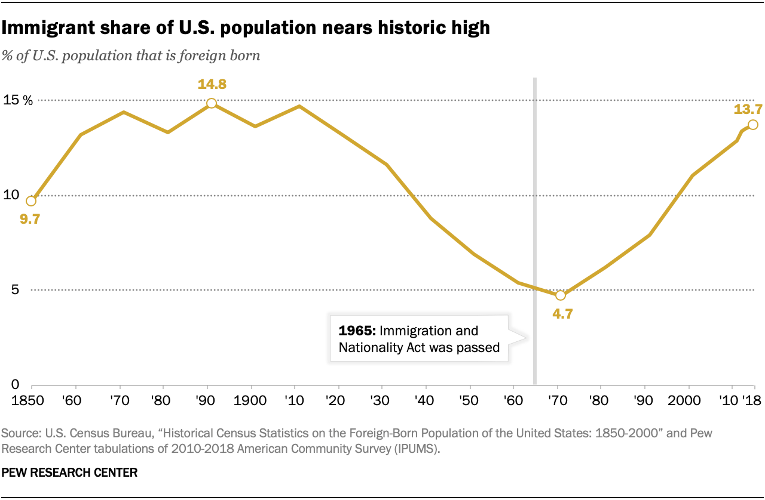

Slide 14
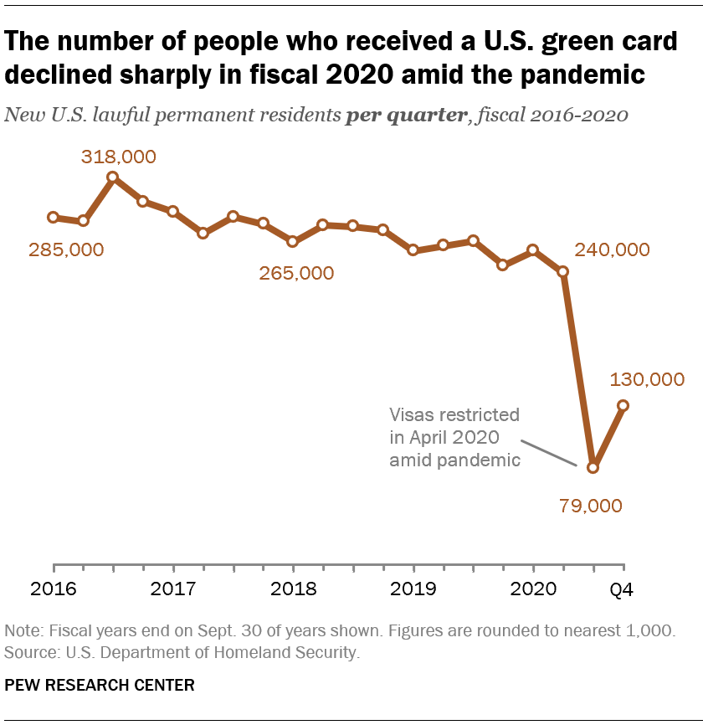
Immigrants

Slide 15
Immigrant Population
Undocumented immigrants have been negatively affected by social determinants of health such as poverty, food and housing insecurity, lack of education, and poor health care access. (Chang, Current Problems in Pediatric Adolescent Health, 2019)
Lower rates of health insurance, use less health care, and receive lower quality of care than U.S.-born populations (Derose, Escarce, Lurie, Health Affairs, 2007)
Signiﬁcant language and health literacy difficulties, cause difficulty in accessing and making sense of relevant health information (Johnson, Shepard, et al, Health Literacy Research and Practice, 2021)

Slide 16
Immigrants
Perceive that existing health services and information are not sensitive to cultural, faith, language or literacy needs of diverse communities (multiple studies and focus groups).

Slide 17
Barriers
Immigrants
Not qualified for Medicaid, SNAP, many rental assistance programs
Language
Low Health Literacy and poor health care prior to arrival
Refugees
Can lose social services if do not gain citizenship after 5 years
Language
Low Health Literacy and poor health care prior to arrival

Slide 18
Stories
FH, 41 y/o female forcibly married to Taliban officer in Afghanistan. Years of DV. Five children taken from her.
Ingrown toenail
Soak toe in Epsom salts BID, cover with Neosporin and bandaid and RTC in 2 weeks

Slide 19
Stories
23 year old woman (HH)
Congenital problems led to many surgeries with complications, sepsis leading to need for dialysis
Denied for renal transplant due to:
Inability to access interpreter,
Lack of basic English,
Non-adherence with medications and appointments,
Unsafe housing
Barriers:
Rare language
Cognitive deficits
Illiterate in own language
Transportation
Unemployment/Financial stress

Slide 20
HH Update
Participating in ESL classes
Mother has taken over medication management
Family moved to own apartment
Identified interpreter
Knows how to contact hospital independently to request assistance
Consistently attending appointments

Slide 21
Stories
CM-- 24 y/o female from Uganda with 5 year old and newborn.
CPS threatened when in postpartum unit
Formerly homeless following DV
Illiterate in native language
Economic instability (unemployed, SNAP/WIC, housing, poverty)
Education (ECE for son, CM motivated to take ESL but…, language and literacy—interpreter problems)
Social and Community Context-discrimination, culture in Uganda following childbirth
Health Literacy
Neighborhood—crime and violence, housing, access to food

Slide 22
Stories
SD, 70 y/o man from Mauritania
Speaks particular dialect of Fulani—often has difficulty getting appropriate interpreter
Unable to work due to poor vision, no income
Unable to pay rent, no cell phone service, no transportation, unable to buy food
Lacked transportation to appointments
Unable to manage medications despite color coding and marks to bottles

Slide 23
Stories
MM, 48 y/o female from Honduras
Poorly controlled DM2
Taught to administer insulin and do finger stick blood glucose checks while in hospital
Returned home and injected insulin into fingertips

Slide 24
Good health literacy practices:
Assess language, educational level and literacy;
Provide clear written and oral communication (between patients and health care professionals using appropriate interpreters) and
Visual tools (such as pictures, video and other non-written means of communication),
Return demonstrations, and
Follow-up.

Slide 25
Lessons Learned
Impossible to separate health literacy needs from SDOH
Multiple forms of communication needed
Creative strategies for health teaching needed
Enlist support of family, members of community when appropriate
Requires a huge amount of time and a lot of follow up

