Slide 1
Count Me In or Count Me Out?
The Role of Numeracy Literacy in Health Disparities
Teresa Wagner, DrPH, MS, CPH, RD/LD, CPPS, CHWI, DipACLM, CHWC
Nutrition and Health Literacy Consultant
President and Founder, Health Literacy Texas
wagnert@ymail.com

Slide 2
Objectives
Define
Define numeracy related to using numbers in every day life.
Discuss
Discuss risk, outcome, benefit, statistics, relative risk and absolute risk as they relate to numerical health information.
Examine
Examine risks and benefits using numeracy of health information from an individual’s perspective.
Analyze and communicate
Analyze and communicate numerical health information to others.
Operationalize
Operationalize resources for numerical health information.

Slide 3
What is Numeracy?
Numeracy means knowledge and skills to use math in a wide range of ways.
It involves having self-efficacy in math to solve number related tasks.
Notes:
Victoria, Australia Education: https://www.education.vic.gov.au/school/teachers/teachingresources/discipline/maths/Pages/numeracy-for-all-learners.aspx#link48

Slide 4
Why is Numeracy Important?
Math gives access to numerical ideas, knowledge and skills.
Numeracy connects math with our personal and work lives.
Notes:
Victoria, Australia Education: https://www.education.vic.gov.au/school/teachers/teachingresources/discipline/maths/Pages/numeracy-for-all-learners.aspx#link48

Slide 5
How Does Numeracy Impact Equity?
Numeracy plays an important role in equity.
It helps people keep up with cultural, social, economic and high-tech advances.
Notes:
Victoria, Australia Education: https://www.education.vic.gov.au/school/teachers/teachingresources/discipline/maths/Pages/numeracy-for-all-learners.aspx#link48

Slide 6
How Does Numeracy Impact Health Equity?
Many health-related tasks rely on numeracy:
Reading food labels
Taking medications
Interpreting blood sugar
Understanding health risks
These tasks often require patients to work out which math skills to use and then be able to use them in multi-step processes.
Patients who had a hard time learning math in K-12 may be overwhelmed, intimidated or simply lack the skills to call upon to complete medical tasks.
Notes:
https://cbrhl.org.au/health-services-providers/communicating-with-consumers/communicating-risk-and-benefit/#_edn1

Slide 7
How Does Numeracy Impact Health Equity?
Low numeracy distorts perceptions of risks and benefits of screening.
It reduces medication compliance, impedes access to treatment, and impairs risk communication (limiting prevention efforts among the most vulnerable).
Based on the scant research appears to adversely affect medical outcomes.
Reyna et al., 2009
Notes:
Reyna, V. F., Nelson, W. L., Han, P. K., & Dieckmann, N. F. (2009). How numeracy influences risk comprehension and medical decision making. Psychological Bulletin, 135(6), 943–973. https://doi.org/10.1037/a0017327

Slide 8
How Does Numeracy Impact Health Equity?
Low numeracy increases susceptibility to effects of mood or how information is presented (e.g., as frequencies vs. percentages).
Biases judgment and decision making (e.g., framing and ratio bias effects).
Reyna et al., 2009
Notes:
Reyna, V. F., Nelson, W. L., Han, P. K., & Dieckmann, N. F. (2009). How numeracy influences risk comprehension and medical decision making. Psychological Bulletin, 135(6), 943–973. https://doi.org/10.1037/a0017327

Slide 9
Numerical Health Information Definitions
Risk: Possibility of loss, injury or other adverse or unwelcome circumstance
Outcome: The way something turns out, a result
Benefit: Advantage, profit, good
Statistics: Systematic collection and arrangement of numerical facts or data
Evidence: Something serving as proof
Notes:
Strategies to Enhance Numeracy Skills, 2016, by Andrew Pleasant, Megan Rooney, Catina O’Leary, Laurie Myers, and Rima Rudd.
Canberra Health Literacy: Communicating Risk and Benefit to Consumers https://cbrhl.org.au/health-services-providers/communicating-with-consumers/communicating-risk-and-benefit/#_edn6

Slide 10
Health consumers perceive risk and benefit differently than clinicians. However, it’s a critical part of informed consent and shared decision making.
Communicating Outcomes
Notes:
Canberra Health Literacy: Communicating Risk and Benefit to Consumers https://cbrhl.org.au/health-services-providers/communicating-with-consumers/communicating-risk-and-benefit/#_edn6

Slide 11
Low Health Numeracy
Informed Decision Making
Makes it hard to read, listen to, talk about, and evaluate quantitative information.
Less likely to understand risk and make choices that help them get or stay well.
Treatment Choice
Difficulty understanding statistical information about the possible outcomes of treatments, like probabilities & risks.
Need to understand & be able to use numerical data.
Notes:
Rothman, R.L et al Perspective: The Role of Numeracy in Health Care, J Health Commun. 2008 September ; 13(6): 583–595. doi:10.1080/10810730802281791

Slide 12
Individual Perspective: Risk vs. Benefit
Providers tend give patients all the information and details.
Thinking this will help the consumer understand and make decisions.
Patients just need the bottom line:
“What does this mean for this for me and my individual circumstances and preferences?”
Individual circumstances and preferences:
Previous experiences – either their own or others
Cultural understanding about the disease
Negative perceptions about the disease or treatments
Emotions like fear or uncertainty
Individual resources (health insurance, access to care, social support)
Notes:
Canberra Health Literacy: Communicating Risk and Benefit to Consumers https://cbrhl.org.au/health-services-providers/communicating-with-consumers/communicating-risk-and-benefit/#_edn6

Slide 13
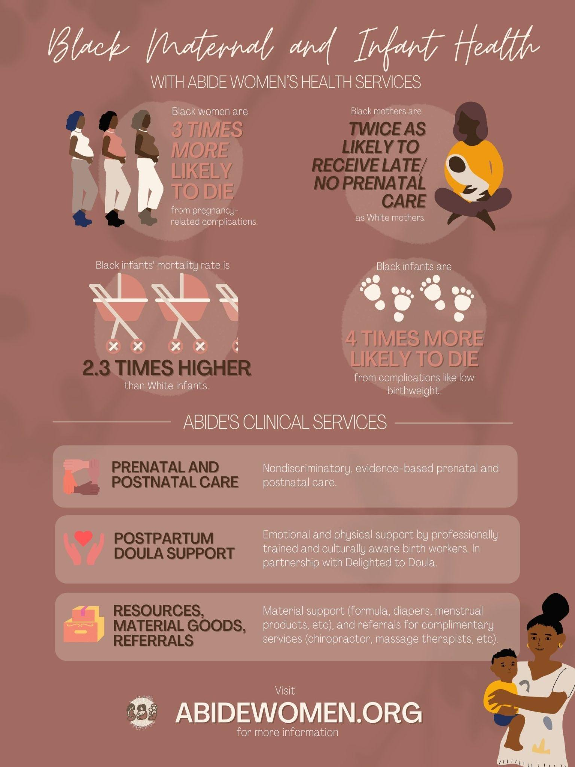
When looking at numerical health data, consider the best way to deliver the risk. Avoid explaining risk in descriptive terms, such as “low risk” or “twice as likely.” Use consistent number formats and figures throughout an explanation
Communicating Outcomes
Notes:
Canberra Health Literacy: Communicating Risk and Benefit to Consumers https://cbrhl.org.au/health-services-providers/communicating-with-consumers/communicating-risk-and-benefit/#_edn6

Slide 14
Individual Perspective: Risk vs. Benefit
Provide context.
For example, what a patient’s cholesterol level is this year versus last year, or compared to others of the same age and with a comparable health history.
It can help to add context to numbers, for example you could say “1 person in 100, which is about 1 person in your street, or 1 in 1000, which is about 1 person in your suburb”.
Use everyday words.
For example, say, “about half” instead of “49 percent.”
Avoid jargon
Avoid long decimals
Metric vs. Imperial
Use analogies and comparisons to familiar objects. For example, say, "A gallstone can be as small as a grain of sand or as large as a golf ball."
Notes:
Canberra Health Literacy: Communicating Risk and Benefit to Consumers https://cbrhl.org.au/health-services-providers/communicating-with-consumers/communicating-risk-and-benefit/#_edn6
Another tip for effectively communicating health information is to use common words and measurements. Avoid jargon or technical language wherever possible. Avoid long decimals. Find out which measurement system the target audience usually uses—metric or imperial. For example, say, "Would you like me to explain using ounces or grams?" It’s best to avoid making assumptions and just ask people their preferences.

Slide 15
Individual Perspective: Risk vs. Benefit
Do the math for them.
For example, tell them what their risk is rather than expecting them to calculate it from a graph.
Use the teach-back technique.
Check for understanding when you explain risk or use a graph or table.
Add good visual aids to risk discussions.
Help patients see the risk numbers in context, thus, giving them information and not just data.
Notes:
Canberra Health Literacy: Communicating Risk and Benefit to Consumers https://cbrhl.org.au/health-services-providers/communicating-with-consumers/communicating-risk-and-benefit/#_edn6

Slide 16
Things to Consider
Topic
Geographical area
Broad or specific?
Population(s)/ group(s) described
Race? Sex? Age? Nation?
Health history?
Socioeconomic factors?
Time period and time frame
1 year? 5 years? Lifetime?
Absolute vs relative risk
Benefits and outcomes expressed
Data expression
Number, percentage, decimal
Notes:
Canberra Health Literacy: Communicating Risk and Benefit to Consumers https://cbrhl.org.au/health-services-providers/communicating-with-consumers/communicating-risk-and-benefit/#_edn6

Slide 17
How can we improve numerical health information?
How Many Doses Are Needed?
Covid-19 vaccines require 2 doses to get the most benefit.
1 DOSE = about 50% protection
2 DOSES = about 95% protection
Notes:
Data can be written in different ways that ultimately convey the same meaning. All of these numbers reflect data the same way, but are displayed differently. Some people may understand one better than the other. If numbers aren’t the ideal method of communication in a given situation, there are other ways this data can be presented. Sometimes, it's best to leave the numbers behind and use a visual to interpret and display information.
NLM Toolkit: https://nnlm.gov/training/class-catalog/making-sense-numbers-understanding-risks-and-benefits-communicating

Slide 18
Visuals
Visuals, such as tables, pie charts, icons, infographics, and pictures can be helpful tools for communicating health information.
Make the presentation of complex data or information not only more attractive, but also easier to understand.
Visuals can reinforce written or spoken health messages.
Focus on a few numbers at a time, and the most relevant information.
Notes:
Read slide.
NLM Toolkit: https://nnlm.gov/training/class-catalog/making-sense-numbers-understanding-risks-and-benefits-communicating
Corona Virus Network: https://www.coronaviruspreventionnetwork.org/how-mrna-vaccines-work/

Slide 19
Icon Arrays
When using numbers, explain them clearly & visually.
You might say: “3 out of 100” instead of “3%.”
For example, an icon array: “out of every 100 people who get screened, 3 people may test positive.”
This works better to portray frequencies, rather than using percentages.
Notes:
An icon array is a visualization where one shape is repeated a specific number of times to represent the “whole”; then, some of the shapes are altered (in this case, by color) to represent a proportion. Icon arrays are very useful when communicating numbers because they are generally easy to understand when used in the right context. This icon array does a great job depicting how many people develop a blood infection in our example.
When using visuals to communicate numerical information, consider this:
Where should you look first?
What path are you supposed to follow through the chart or diagram?
What connections must you make to extract information from such formats?
I like how this icon array shows the 3 people highlighted at the bottom, which probably means I will look at 97 people who do not develop blood infection before getting to the 3 that will. This might be a great way to positively frame this data. We will talk more about framing later.
NLM Toolkit: https://nnlm.gov/training/class-catalog/making-sense-numbers-understanding-risks-and-benefits-communicating

Slide 20
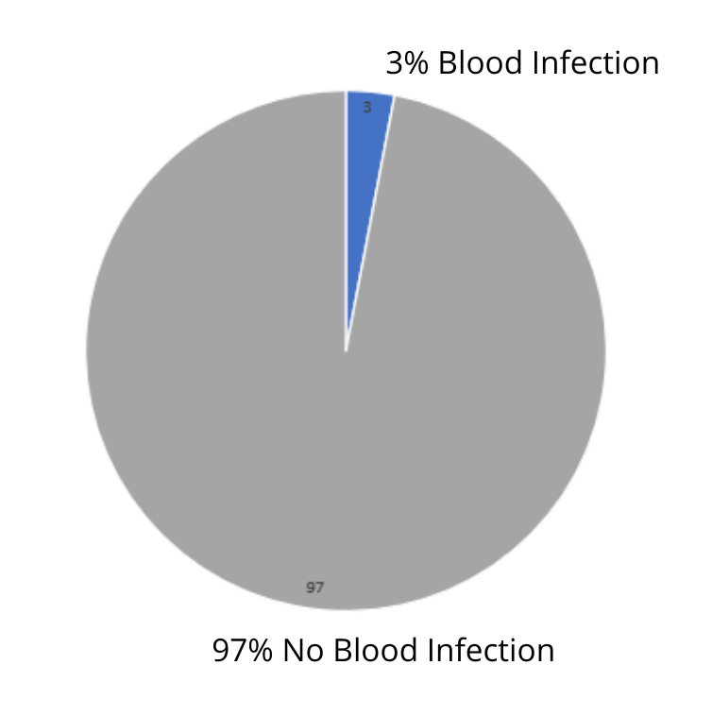
Pie Charts
When using percentages, explain them clearly & visually.
You might say: “3% of people who undergo surgery develop a blood infection.”
Also, show the counter percentage for better context.
Notes:
Charts can also be helpful in visualizing health information. In this example, you see the blood infection data illustrated in a pie chart.
It is important to verify the populations, time frames, genders, race, etc. in a chart to be sure it suits your particular needs or situation. This pie chart is very simple and could be improved by including more information, but it does adequately express the data in our example.
However, charts can be much more complex than this one. Some of you may have experienced charts that made information too difficult to understand. Good charts help us visualize data in a way that makes sense.
This pie chart helps us to visualize how much 3% really is in comparison with the whole, which may affect health outcomes. The manner in which numbers are presented can change the way we see and understand data and make health decisions.
NLM Toolkit: https://nnlm.gov/training/class-catalog/making-sense-numbers-understanding-risks-and-benefits-communicating

Slide 21
Tables
Result
Blood Infection
Percentage
3%
Infection Free
97%
Notes:
This table shows us another way the numerical data in our blood infection example could appear.
NLM Toolkit: https://nnlm.gov/training/class-catalog/making-sense-numbers-understanding-risks-and-benefits-communicating

Slide 22
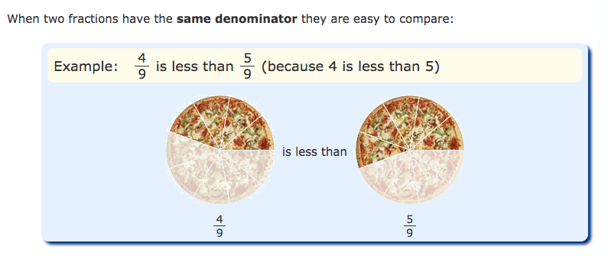
Fractions
Keep denominators and timeframes the same when you compare numbers.
For example, don’t say: “1 in 5 compared to 1 in 4”.
Do say: “4 out of 9 compared to 5 out of 9”.
Notes:
Math is Fun: Comparing Fractions https://www.mathsisfun.com/comparing-fractions.html

Slide 23
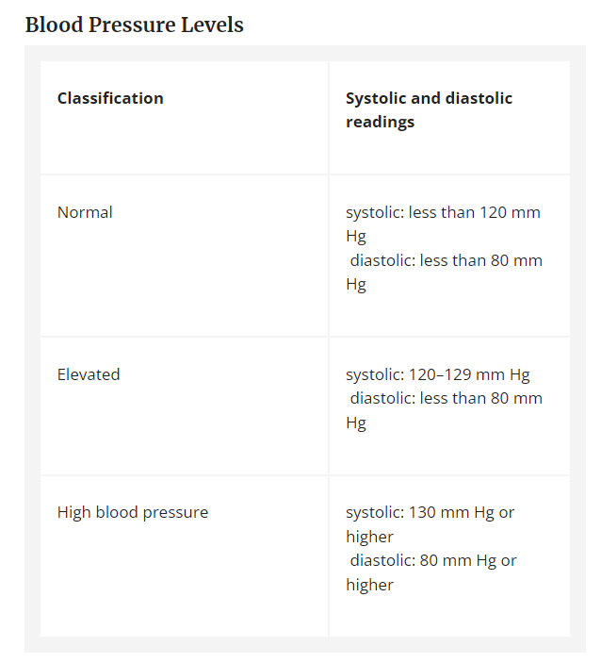
Measurements
This table shows numerical health data as measurements, in this case measurements of blood pressure expressed as ranges.
Other ways to express measurements include mass, volume, length, height, and more.
Notes:
Think of someone in your life: would this table and measurement expression be a good way to communicate this data with them? If not, using what you’ve learned during this presentation, think about how this table could be improved to make it more understandable? It’s always important to consider the target audience when interpreting or presenting numerical health data.
NLM Toolkit: https://nnlm.gov/training/class-catalog/making-sense-numbers-understanding-risks-and-benefits-communicating

Slide 24
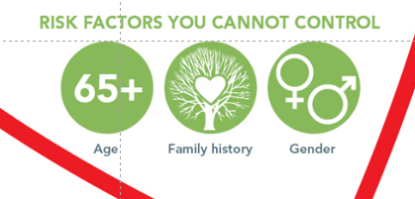
Infographics & Pictograms
Notes:
Lastly, let’s talk about infographics. An infographic is an illustration that uses graphic elements to present information in a visually striking way.
Technically, tables, charts and icon arrays are infographics; colloquially speaking, however, images like the one on this slide are typically associated with the term “infographic”. The infographic here provides a visual representation of risks we can and can not control when it comes to heart attack and stroke. This information is generalized to all populations and refers to the “standard” risk that increases risk of heart attack and stroke. It does not address a specific population.
Within this graphic, you will notice pictograms (or pictographs), which are small icons that visually communicate a concept concisely. We have some of them highlighted and enlarged here. As you can see, numerical data is well-communicated about the age group that’s considered at risk for stroke by a green circle with “65+” inside of it that is labeled “Age”.
NLM Toolkit: https://nnlm.gov/training/class-catalog/making-sense-numbers-understanding-risks-and-benefits-communicating

Slide 25
Are the words in this infographic meaningful in terms of understanding the data? Or, does it require higher-order thought?
Is the numerical health information understandable?
Notes:
Are these words and this infographic meaningful in terms of understanding the data? Or, does it require higher-order thought?
Abide Women: www.abidewomen.org

Slide 26
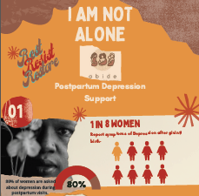
Is the numerical health information understandable?
Notes:
Are these words and this infographic meaningful in terms of understanding the data? What’s different?

Slide 27
Communicating Numerical Health Information

Slide 28
Clear Communication: Risk vs. Benefit
Health Information is used to:
Persuade (screenings, immunizations)
Make Message Clear
What data needs to be communicated?
Compare (medications, treatment, therapy)
Motivate (quit smoking, exercise)
Is it formatted so that communication is as clear as possible?
Are we looking at death? Injury? Diagnosis? Risk?
How big is the risk? Benefit?
Notes:
https://cbrhl.org.au/health-services-providers/communicating-with-consumers/communicating-risk-and-benefit/#_edn1

Slide 29
Framing
80% of Americans will not die of cancer.
More than 20% of Americans may eventually die of cancer.
Frame outcomes in both positive and negative terms.
Notes:
Studies show that the way we hear and understand health statistics can be influenced by how the numbers are described.
How we present the risk is important. You can present risk in a negative manner (focused on the negative outcome), or in a positive manner (focused on the positive outcome).
“More than 20% of Americans may eventually die of cancer” might sound less scary from a different perspective: “Nearly 80% of Americans will not die of cancer.”
NLM Toolkit: https://nnlm.gov/training/class-catalog/making-sense-numbers-understanding-risks-and-benefits-communicating

Slide 30
Ratio
Almost 4 out of 5 Americans will not die of cancer.
Notes:
The same information might seem clearer described as a ratio, which might sound something like: “Almost 4 out of 5 Americans will not die of cancer.”

Slide 31
Ratio: Show Pictures
1 out of 4 American men die of heart disease
Notes:
Information might seem clearer described as a ratio, with an accompanying picture: “1 out of 4 American men die of heart disease.”

Slide 32
Relative Risk
Many people have trouble understanding probability estimates.
Use absolute risk instead of relative risk.
For example they may think that a risk of 1 in 200 is greater than a risk of 1 in 25.
Notes:
Paling, J. Strategies to help patients understand risks, British Medical Journal, 2003; 327: 745-748.

Slide 33
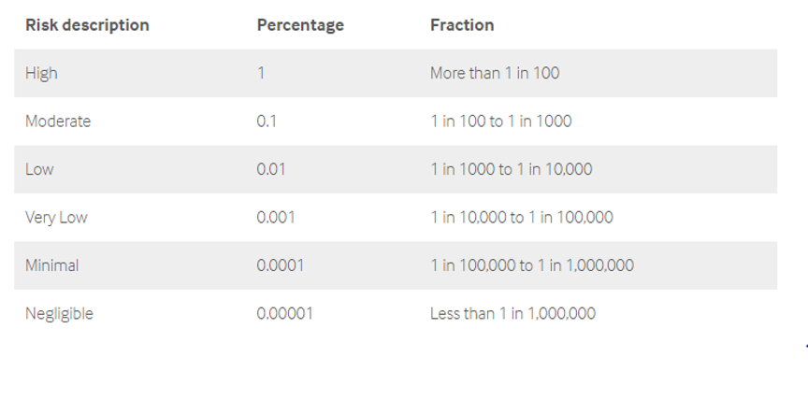
Describe Numbers and Define Words
Say “1 out of 10 times” rather than “10% of the time”.
This table represents as example of defining risk level in both percentages and fractions/ratios.
It is not specific to any one disease or a general gauge for risk.
Notes:
Describe numbers and define words. Use number formats and phrases that might make the most sense to your target audience.
For example, “myocardial infarction” means the same thing as “heart attack”
In some cases, we can just say "about half" instead of "49 percent"
It can also be helpful to define risk ash high, moderate, and/or low and what those look like in number form or visually
This table shows different ways someone could communicate about risk. This is not specific to any one disease or a general gauge for risk, but is only used to illustrate how risk might be communicated.
Use MedlinePlus as a resource for further information on health topics, word definitions, etc. for consumers - in this situation, consumers are everyday folks like you and me.
NLM Toolkit: https://nnlm.gov/training/class-catalog/making-sense-numbers-understanding-risks-and-benefits-communicating

Slide 34
Relative vs. Absolute Risk
Relative Risk
Comparison between two groups of people, or in the same group of people over time. Can be given as a ratio.
Example: “Smokers have 2 times the risk of having a stroke in their lifetime.”
Absolute Risk
The number of people experiencing an event in relation to population at risk.
Example: “3 out of 1,000 nonsmokers vs. 6 out of 1,000 smokers may have a stroke in their lifetime.”
Notes:
Explain absolute vs relative risk when necessary.
"3 out of 1,000 nonsmokers may have a stroke in their lifetime, while 6 out of 1,000 smokers may have a stroke in their lifetime," instead of "Smokers have 2 times the risk of having a stroke in their lifetime.“
Both of these are correct, but it’s important to think about how particular framing might motivate people to do something, or to start working with health care providers to improve their health.
Remember: When communicating with people, give absolute risk instead of relative risk. Absolute risk estimates the number of health events among individuals in a group, and gives a better sense of personal or individual risk. When you hear numbers about risk, it’s best to focus on the absolute risk.
Paling, J. Strategies to help patients understand risks, British Medical Journal, 2003; 327: 745-748.

Slide 35
Show Pictures

Slide 36
Show Pictures

Slide 37
Let’s Practice

Slide 38
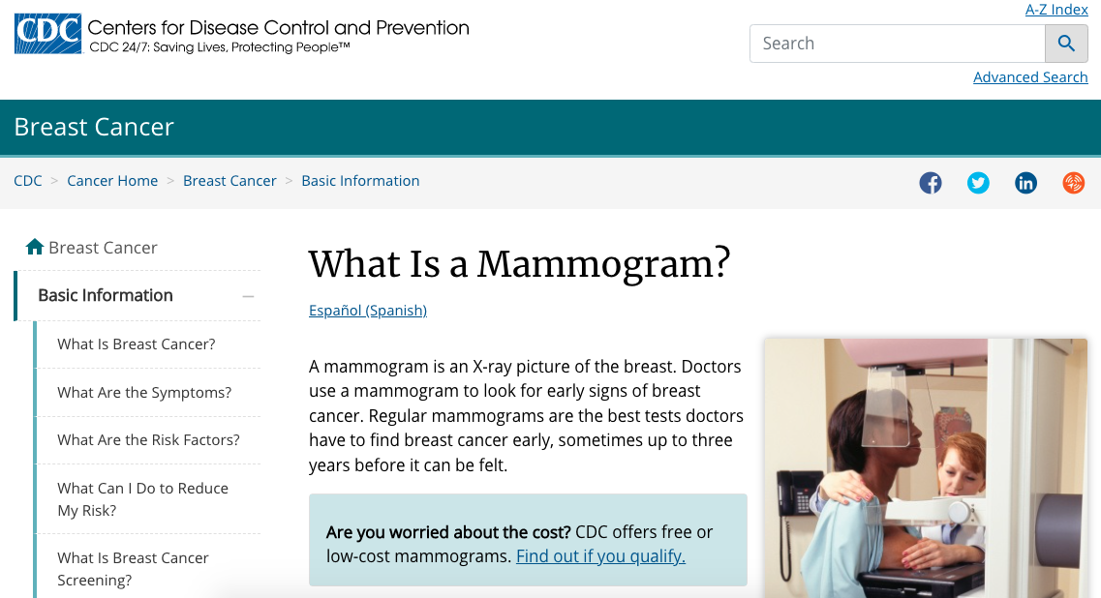
Scenario 1
Katy is 58 and her doctor is encouraging her to receive a mammogram, but she is unsure what that is and afraid to ask.
She goes home to begin searching for information.
She sees online that 13% of women will be diagnosed with invasive breast cancer and 3% will die from it.
To Katy, the terms and numbers are confusing, and she is unsure how to move forward.
Notes:
Describe numbers and define words. Use number formats and phrases that might make the most sense to her.
For example, “mammogram” means the same thing as “screening for breast cancer”
Perhaps use an icon array to display risk and use absolute vs. relative risk to help her interpret the numbers.
Use credible resources for further information on health topics, word definitions, etc. for consumers - in this situation, consumers people like you and me.

Slide 39
Scenario 2
Cheryl’s doctor prescribed her alendronate for her osteoporosis.
She asked her doctor how likely it is that she will avoid a hip fracture by taking this medication.
Her doctor responded, “if 15 patients are treated, 1 will benefit.”
Cheryl is unsure if this medication will provide a good benefit for her.
Can you help Cheryl understand the benefit on this drug?
Notes:
NLM Toolkit: https://nnlm.gov/training/class-catalog/making-sense-numbers-understanding-risks-and-benefits-communicating

Slide 40
Solution 2
1/15 patients will benefit = 0.07 = 7%
7/100 patients who take alendronate for osteoporosis will avoid hip fracture
Notes:
Break down the numbers differently.
Use MedlinePlus and other credible resources for further information on health topics, word definitions, etc. for consumers - in this situation, consumers are people like you and me.
NLM Toolkit: https://nnlm.gov/training/class-catalog/making-sense-numbers-understanding-risks-and-benefits-communicating

Slide 41
Conclusion
Before you can communicate data, you need to ensure you can interpret it.
When you’re communicating about risk, as it relates to health or medicine, it’s important to provide context to the information you’re sharing.
Be clear on your message
Consider Framing, using absolute risk
Limit numbers
Use common words
Describe what numbers mean
Show pictures
Use teach-back
Your purpose and situation will determine the format you will use in communicating risk and benefits/other health information

Slide 42
Questions?

