Slide 1
More Than Pretty
How to Design Information that Connects Coloradans to Care
Presented by: Nicky Alden and Yamairah Keller

Slide 2
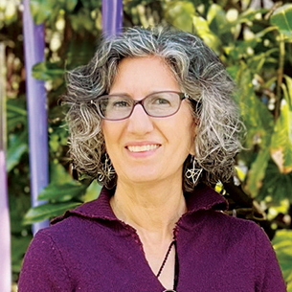

Today’s Presenters
Nicky Alden
Yamairah Keller
Brand Manager & Design Lead
Senior Design Manager
Notes:
Name, title, how long at HCPF we manage medicaid

Slide 3





Workshop Objectives
Understand how visual design supports health literacy.
Learn strategies to make information more accessible and effective.
Practice evaluating and improving materials.

Slide 4



Ground Rules
Interaction encouraged.
Judgement-free zone.
All experience levels.

Slide 5
Why Design Matters in Health Literacy

Slide 6
What is “health literacy”?
Personal health literacy:
  How well people can find, understand, and use information and services to inform health-related decisions and actions for themselves and others.
Organizational health literacy:
  How well organizations enable individuals to find, understand, and use information and services to inform health-related decisions and actions for themselves and others.
Source: What Is Health Literacy?
Notes:
In 2020 the CDC updated their definition of Health literacy to include Organization Health Literacy.
Read definitions.
How are we enabling people to use the information we’re providing?

Slide 7

How does our work impact health literacy?
We can communicate information about health programs or plans in a way that helps people to understand, access and use their services.
Source: What Is Health Literacy?
Notes:
How does our work impact health literacy?
I like to think that word ‘enable’ also means empower. That's where we come in.
We can communicate information about health programs or plans in a way that helps people to understand, access and use their services.
If people understand the information we are sharing we are empowering them to take action for their own health care.

Slide 8
How does health literacy impact health outcomes?
  Medication errors.
  Difficulty following care plans.
  Reduced use of preventive services.
  Challenges managing chronic conditions, which then result in:
    Longer hospital stays.
    Higher mortality.
    Lower trust in agencies.
Confusing materials
can lead to delayed or missed care.
Source: What Is Health Literacy?
Notes:
Confusing materials = delayed or missed care.
Health literacy is lower among older adults, racial/ethnic minorities, and individuals with lower incomes.
There are lots of impacts when communication is unclear, some of the top are:
Medication errors;
Difficulty following care plans;
Reduced use of preventive services;
Challenges managing chronic conditions; which then result in:
Longer hospital stays;
Higher mortality.13,14
Lower trust in government agencies and those that help.

Slide 9
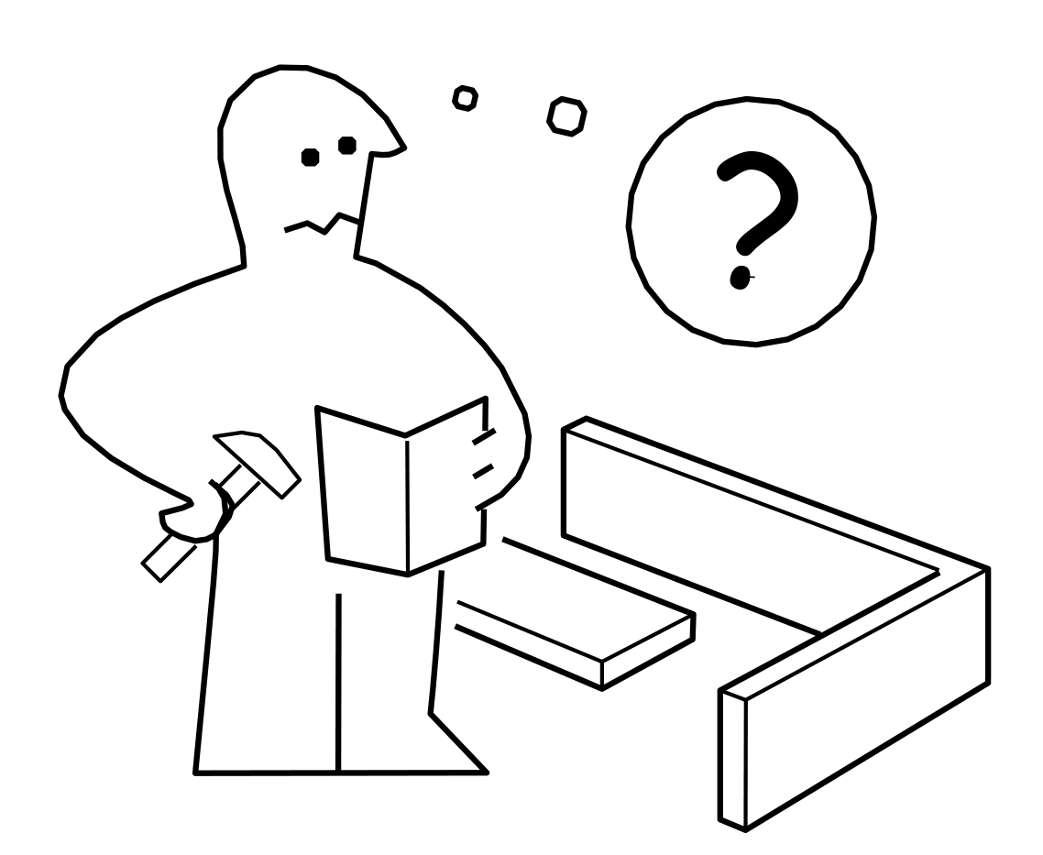
How can design impact health literacy and health outcomes?
Design is
communication
Notes:
Ikea - if you’ve ever put together a piece of ikea furniture, you understand the importance of clear, visual communication. Assembly manuals use minimal words and mostly images and steps to guide you through the process. Although I’m not always successful on the first try.

Slide 10
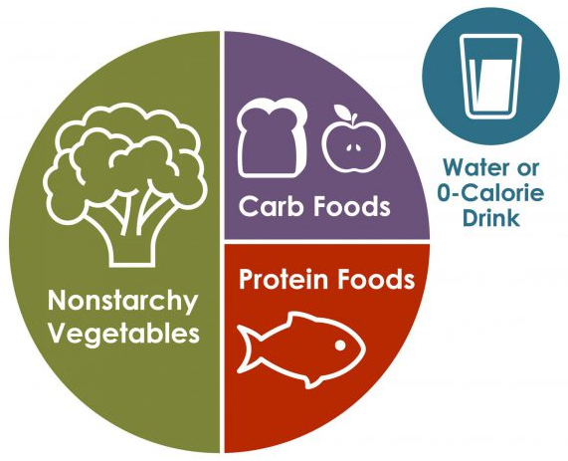
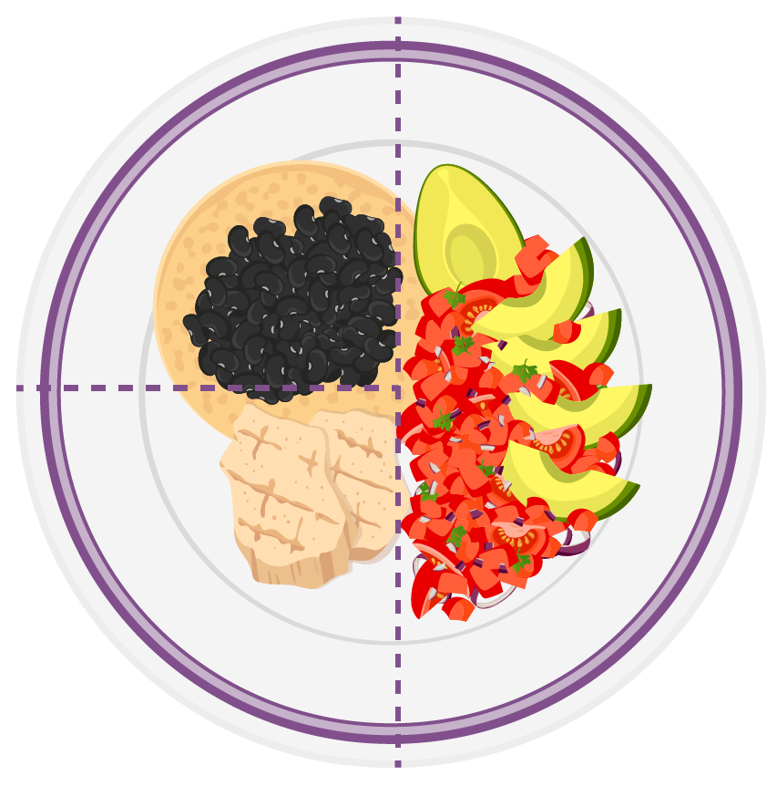
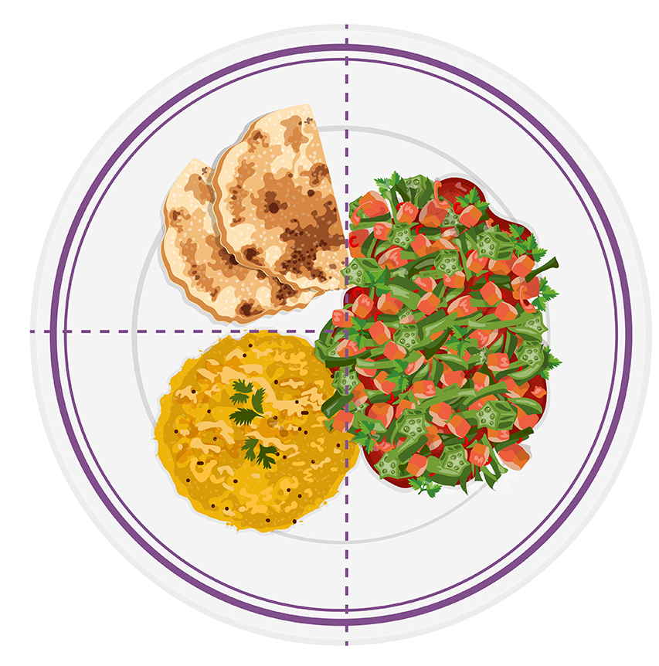
How can design impact health literacy and health outcomes?
Notes:
The CDC does a good job of making this complex information easier to understand in the Diabetes Self Management Education toolkit DMES Health Literacy tools example.
Latin plate with 1/2 salad with salsa, 1/4 grilled chicken, and 1/4 beans.
Indian plate with 1/2 bhindi masala, 1/4 lentils, and 1/4 whole grain roti bread.
I’m not suggesting we use only images to communicate with our audience, but they can be very helpful when used correctly.

Slide 11
Core Design Principles for Health Communication

Slide 12







Core Design Principles
Cultural & Contextual Relevance
Plain Language
Typography & Color
Images, graphics, and icons
Hierarchy & Layout
Accessibility
Consistency

Slide 13
Plain Language
Write for your audience.
Break content into organized and logical chunks.
Write in active voice.
Notes:
Think Clarity over jargon.
Write for your audience (patient, partner, medical professional).
Break content into organized and logical chunks, striving for paragraphs with 1 topic and 2 to 3 sentences.
Write in active voice, choose words your audience knows and avoid jargon.

Slide 14
Hierarchy & Layout
Put important information first.
Ask yourself: “Does this heading make sense if it’s all the reader sees?”
Use lists.
Make a clear call to action and draw attention to it.
Notes:
Make information scannable and guided.
Put important information first with meaningful headings and use subheadings to highlight sections. Ask yourself: “Does this heading make sense if it’s all the reader sees?”
Use lists: bullets for lists, numbers for steps and process.
Make a clear call to action (Mail this back, call this number, fill this out, etc.) and draw attention to it.

Slide 15
Typography & Color
Use a sans serif typeface.
Reserve bold for headings and to call out important content.
Reserve color in text for headings.
Never use all caps in a headline.
Notes:
Think Legibility and emphasis.
Use a sans serif typeface. Reserve the largest type size for the main heading only and second largest for subheadings. Keep the medium in mind, for print copy body should be at least 11 or 12 pts for readability. For slides font size should be larger in most cases, especially if the room is larger.
Reserve bold for headings and to call out important content, such as a date or a phone number.
Reserve color in text for headings and choose colors with high contrast. Only use low contrast/lighter colors for backgrounds or as accent colors.
Never use all caps, especially in a headline, unless it is referencing an acronym.

Slide 16






Images, Graphics, Icons
Choose images and graphics that reinforce important information.
Choose commonly-used icons.
Test images, graphics and icons by asking: “What does this visual mean, does it make sense if it’s all the reader sees?”
Notes:
Reinforce over distraction.
Choose images and graphics that reinforce important information, improve readability and benefit the reader. Don’t add graphics just to add color and fill the page.
Choose commonly used icons that readers are familiar with and have a clear meaning and connection to the content.
Test images, graphics and icons by asking yourself or another person: “What does this visual mean, does it make sense if it’s all the reader sees?”

Slide 17
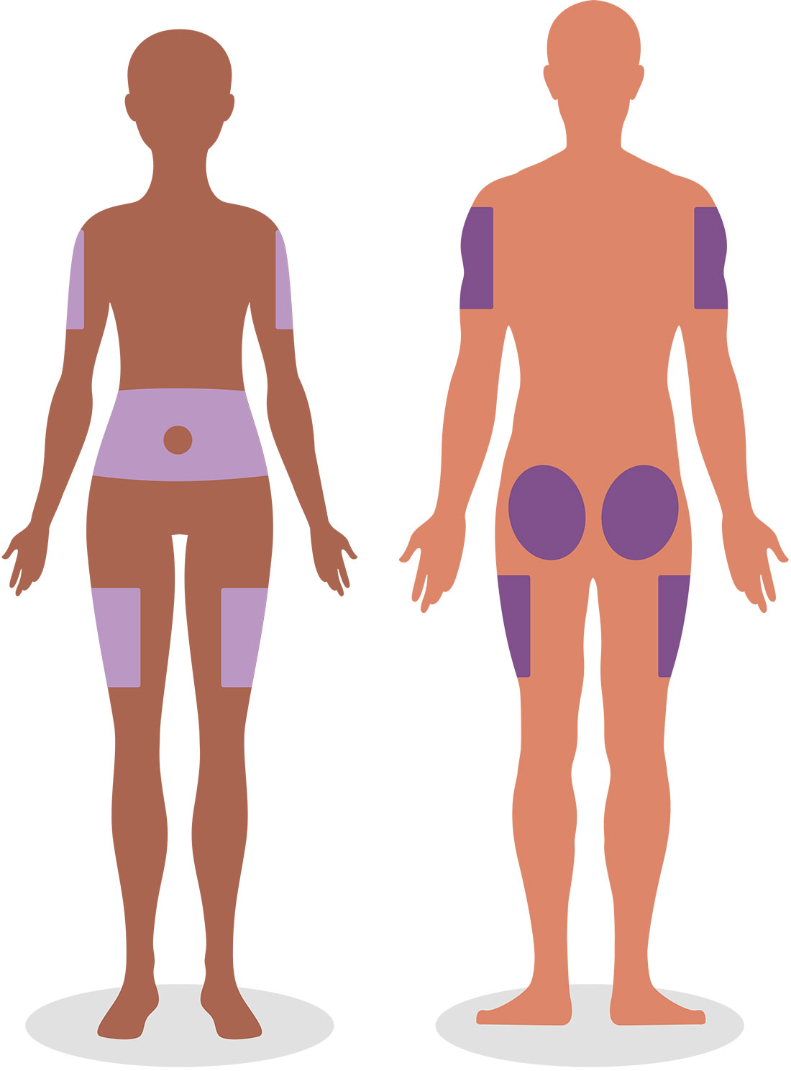
Culture & Context
Avoid idioms.
Choose images that show a variety of ethnicities, ages, abilities, and communities.
  Make sure images don’t stereotype.
Notes:
Reflect and respect diverse communities.
Culture can include race, ethnicity, language, age, gender identification, socioeconomic group, even geographical region.
Avoid idioms as they can be confusing to non-native speakers or those from different cultures.
Choose images that show a variety of ethnicities, ages, abilities, and communities.
Make sure images don’t stereotype (only male doctors with female nurses)

Slide 18
Accessibility
Additional guidelines:
Write alternative text.
Do not use auto hyphenation, drop caps, or extra spaces after periods and paragraphs.
Do not underline text unless it is a link and create meaningful link names.
Notes:
Design for people with disabilities.
Many of these core principles overlap with guidelines for accessibility in communication.
Write alternative text (alt text) for all visuals in digital communication
Do not use auto hyphenation, drop caps, or extra spaces after periods and paragraphs.
Do not underline text unless it is a link. Create meaningful link names that describe their destination or function like “learn more about site” instead of “click here.”

Slide 19
Consistency is key!
Create templates in commonly-used software like Word and/or PowerPoint to speed up production and increase understandability through repeating elements.
Consider creating a language guide specific to your organization and audience highlighting common mistakes and solutions. HCPF has a Member Communications Guide that is frequently updated to reflect changes in guidelines and culture.

Slide 20
Core Design Principles
Cultural & Contextual Relevance
Plain Language
Typography & Color
Images, graphics, and icons
Hierarchy & Layout
Accessibility
Consistency

Slide 21
Real-World Examples

Slide 22
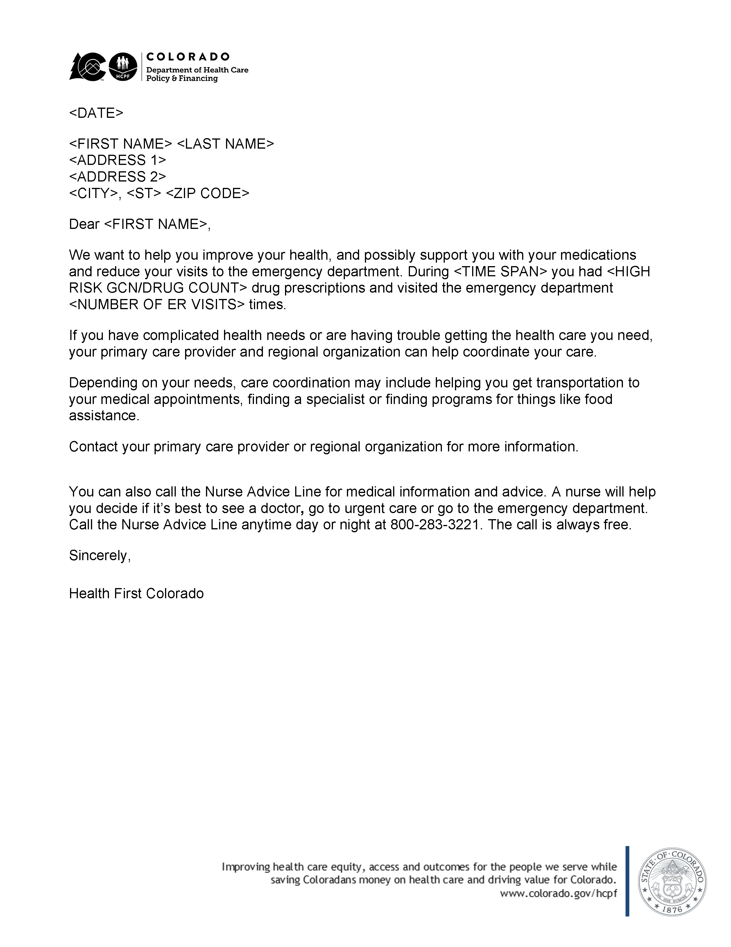
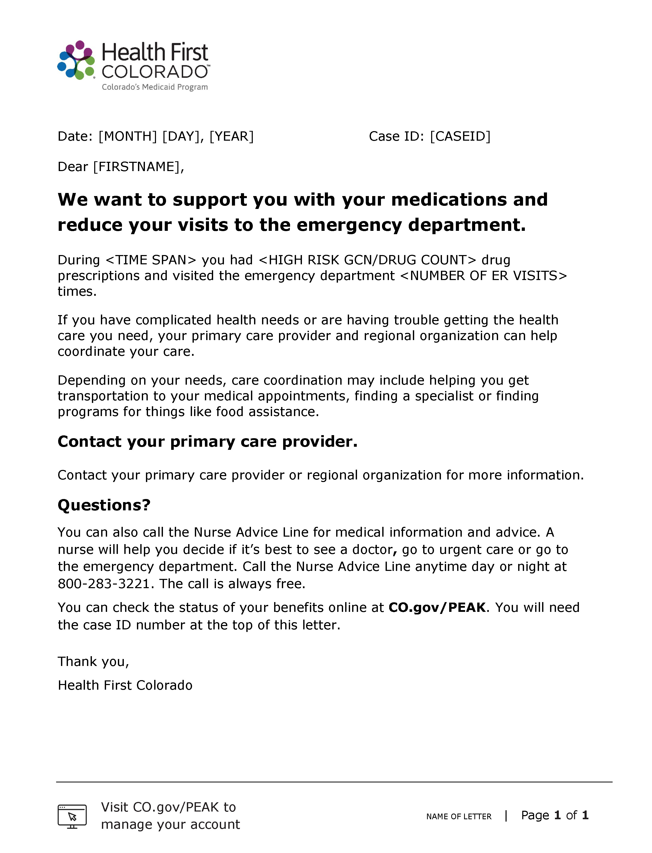
Before and after letters
Before
After
Notes:
Let’s see some work we’ve done at HCPF
We produce a lot of letters to members, they’re generated from they PEAK system where they sign up for Medicaid, they come directly from us, they come from our partners. They often looked like the letter on the left, arriving in an envelope with a state of Colorado seal, with a HCPF logo at the top, mission statement at the bottom and all the text looks the same. So we brought the letter to our Member Experience Advisory council and asked for their feedback. We got a lot, we heard:
The state seal on the envelope causes anxiety bc they are worried about changes to their benefits
The HCPF logo on the letter is confusing, they don’t understand how HCPF connects to their Medicaid services, Health First Colorado. Is this about their services? They’re unsure.
They don’t care about our mission statement.
They mainly care about 2 things: What are we trying to tell them and what do they have to do
We realized we weren’t thinking about our audience, our members. We care about the HCPF logo, that’s who we are, we manage Medicaid, and the mission statement is important to us. But that information isn’t helpful to our members.
So we revamped the letter so it makes sense to them, and they loved it.
The HFC logo tells them it’s about their services
We call attention to what the letter is about, what we want them to do and where to go with questions
Instead of the mission statement we have the website about managing their account, and we put page numbers so they know how many pages the document is in case they get separated.
They’re small changes with a large impact, it’s scannable, it relives some confusion, some anxiety

Slide 23
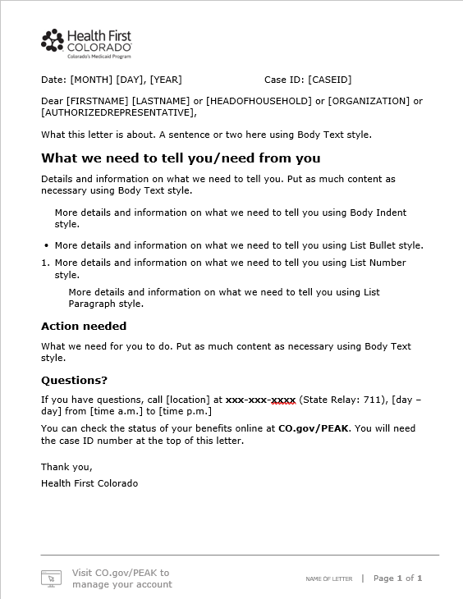
Letter details
Case ID pulled up & to right for easier skimming
Recognizable Logo
Heading
Lists
Call to action
Important information is bolded & a larger font size
Icon & text reinforce info
Notes:
And then, we made it into a template with guided language and using a lot of the tips we’ve shared today.
It’s easy to use whether it’s an internal person, or a partner and the PEAK system has implemented it too.

Slide 24



Design examples
Notes:
More examples:
The left is a flyer I created for our counties and partners to use and customize a bit.
It’s created in Microsoft Word,
I have a heading and call to action emphasized.
We have a qr code if the document is printed and always include the web site the code goes to in case it is emailed or someone doesn’t have a phone/internet access/a qr scanner
Top left is a box where the county or partner can add their contact information as well
The images on the right are created for social media to drive people to and educate them on the Direct Care Careers site
For these I used adobe express, which is similar to Canva
We post information monthly so I created a template so there is consistency in the visuals and message
The focus is on a heading and image to draw folks in because there is supporting copy with the social media post

Slide 25

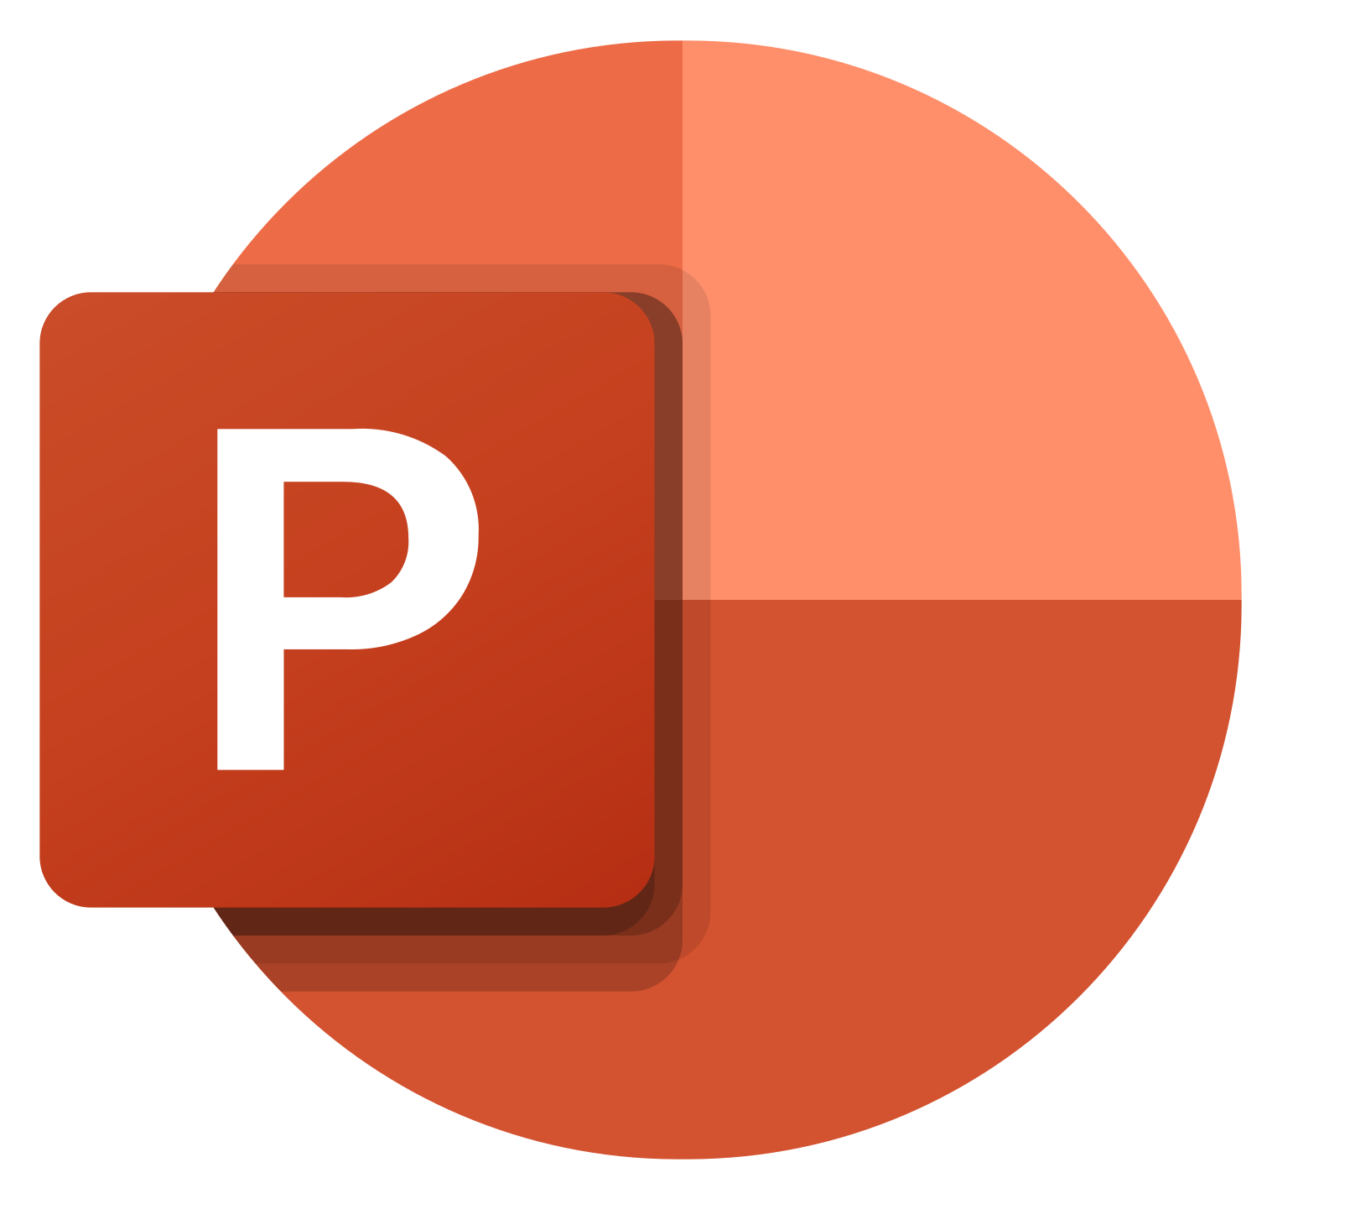





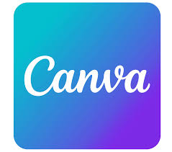
The tools we use
Use AI with caution.
Notes:
Finally, I want to touch on the tools we use and some pros and cons
As a designer I have access to Adobe products, photoshop, illustrator, Indesign. But the majority of staff use Microsoft products (Word, Powerpoint) or Google (slides, docs) and you can do a lot with those tools.
Microsoft products have accessibility checkers built in and there are folks that even create flyers in Powerpoint.
We source photos from Adobe Stock, and the Noun Project is a great resource for icons and simple graphics
Adobe express and Canva are good for creating social media images, and stand alone graphics only. We use it sometimes to edit short videos and adobe express does captions well. But other than captions, neither of these tools have the ability to create an accessible product or even export a product with accessibility built in. You can’t add alt text or tags or control the reading order.
There’s a lot of talk about AI, and here’s our take on it. I don’t advise using AI for any type of photos with people. It’s not there yet and it doesn’t look or feel authentic. Our members are real people and we want images of real people to represent them and connect with them. It’s unreliable for representing diversity or disability. And it writes horrible alt text too.
For text we use AI brainstorming or starting an outline, but always, always review and edit the output. – Yamz?

Slide 26
Questions?

Slide 27
Activity:
Evaluate & Improve

Slide 28

Discuss (10 min)
Present (5 min)
Each table discusses:
What’s working?
What’s confusing?
How could this be clearer?
Volunteer from one table presents:
How did you evaluate?
What did you improve?
Notes:
Bring printouts, several for each table.

Slide 29
Core Design Principles
Cultural & Contextual Relevance
Plain Language
Typography & Color
Images, graphics, and icons
Hierarchy & Layout
Accessibility
Consistency

Slide 30
Recap & Resources

Slide 31
Workshop Recap
Good Design improves Health Literacy, which advances Health Equity.
Applying design principles increases understanding, which promotes healthier behaviors.
Practice makes progress.

Slide 32
Resources for Continued Learning
Diabetes Self Management Education toolkit: DMES Health Literacy tools
What is Health Literacy
PlainLanguage.gov
    Use simple words and phrases
hcpf.colorado.gov/brand page contains:
  HCPF Brand Guide
  Member Communications Standards
The Noun Project
  HCPF Icon Set
  Adobe Stock
  Adobe Express
  Canva

Slide 33
Thank you

