Slide 1
Health Literacy 101: Meeting Our Clients Where They Are At
Brittany Walter, MS, RN, CPN
Patient/Family Education Specialist, Health Literacy Program

Slide 2
Objectives
Review the basic fundamentals of health literacy
Discuss strategies and resources to improve communication skills
Apply clear communication skills using case studies

Slide 3
AMA Health Literacy Video

Slide 4
What’s one word to describe how that video made you feel?

Slide 5
What is health literacy?
Personal: The ability for individuals to find, understand, and use health information and services to make well-informed health care decisions.

Slide 6
Organizational Health Literacy
The degree to which organizations equitably enable individuals to find, understand, and use health information and services to make well-informed health care decisions.

Slide 7
Personal
Organizational
Education
Quality of education
Job
Jobs of family members
Where one lives
Stress
Situation
Transportation
Access to technology
Clear verbal communication
Clearly written materials
Information in primary language
Providing equitable access to information and services
Transportation
Technology

Slide 8
You can determine an individual’s health literacy by knowing what grade they completed in school.
http://www.thenaijaverdict.com/2015/05/men-is-this-true-or-false/

Slide 9
http://melissaagnes.com/false-online-reviews-deal-damaging-internet-posts-business/

Slide 10
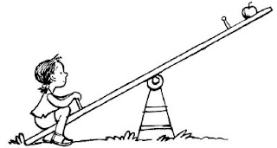
Abilities of clients
Our expectations of clients

Slide 11
How do we meet our clients where they’re at???
Abilities of clients

Slide 12
The Building Blocks of Health Literacy

Slide 13
Create a Shame-Free Environment
Slow down
Considers the individual’s needs
Culture
Religious beliefs/rituals
Learning/physical limitations
Gender identity
Ask open-ended questions
Create a
Shame-Free Environment
“What questions do you have?”

Slide 14
Case Study One
Leadership at your organization has identified creating a welcoming, shame free environment for clients as a top priority. They reach out to you to come up with simple ways to improve the client experience.
Brainstorm strategies for creating a shame-free environment for clients. Consider the following questions:
How can you improve way-finding or physically navigating the space?
How can you improve the check-in process?
What other ways can you create a welcoming environment?

Slide 15
Living Room Language
Curse of Knowledge
Use familiar terms that you would use in your own living room.
Focus on using plain, non-medical language.
Use “Living Room” Language
Create a Shame-Free Environment

Slide 16
Let’s play the Plain Language Game!
Jargon
Administer…...............
Frequently.................
Consider....................
Provider....................
Assist....................
Demonstrate..............
Inflammation..............
Plain Language
Give
Often, a lot
Think about
Doctor
Help, aid
Prove, show
Swelling, painful to touch, redness

Slide 17
Case Study Two
Now in this semi-post pandemic environment, your supervisor is asking all team members to teach clients how to effectively wash their hands. Brainstorm with your group how you will teach clients about hand hygiene.
Consider the following questions:
How will you communicate the importance of good hand hygiene using plain language?
How will you explain how to wash your hands in a way that is easily understood?

Slide 18
Use clearly written materials and resources
Easy to read design
Use logical organization
Reduce complexity
Use Clearly Written Materials and Resources
Use “Living Room” Language
Create a Shame-Free Environment

Slide 19
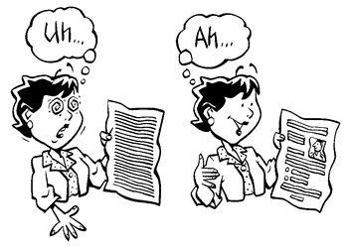
Design styles that make reading easier:
Headings
Bullets or check boxes
Numbered lists/steps
Gender neutral pronouns
They/them/their
More white space and less text
Appropriate pictures/drawings
http://www.plainlanguageaustralia.com/about_pl.html
http://impromptuguru.com/

Slide 20
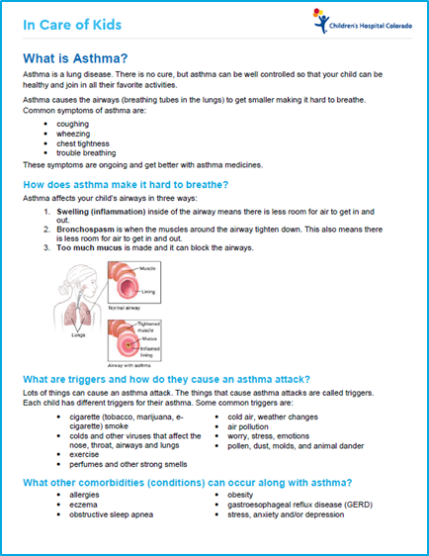
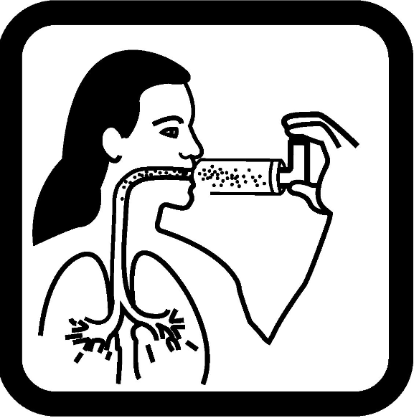
Easy to read handouts
Helpful images

Slide 21
Use Logical Organization
Anticipate questions the reader may have
Put most important point first
Decide on 3-5 key points
Focus on the “need to know” not the “nice to know”
Focus on the action the reader should take

Slide 22
Reduce Complexity
Shorter sentences
Plain language
Bulleted lists
Active voice
Familiar Pronouns

Slide 23
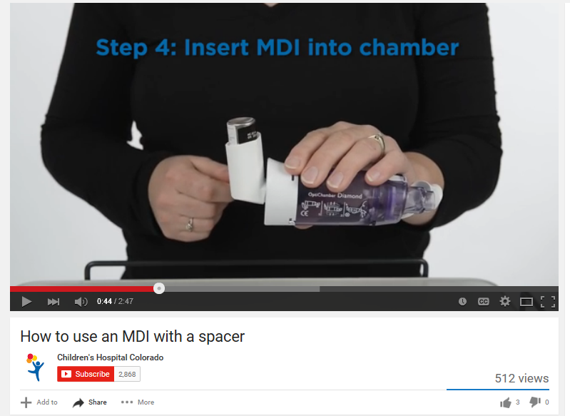
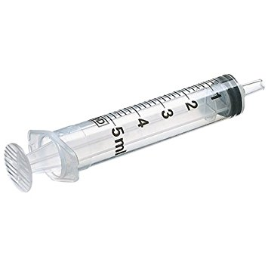
Consider using teaching tools and supports
Educational Videos
Other education tools

Slide 24
Case Study Three
You have been asked by your colleague to write up a brief one-pager about the benefits of drinking water and limiting sugar sweetened beverages (soda, juice, etc.) that can be passed out at a health fair.
Discuss the following questions:
What is “need-to-know” information versus “nice-to-know information?”
What are some examples of actions the reader can take?
**Come up with 3-5 sentences using the techniques discussed today

Slide 25
Use Teach Back
Use
Teach Back
Gold standard for assessing knowledge/understanding
Ask the client to explain using their own words (not yes/no).
The “show me” method
Use Clearly Written Materials and Resources
Use “Living Room” Language
Create a Shame-Free Environment

Slide 26
Teach-Back: Chunk and Check
If you are teaching more than one concept, remember to “chunk and check”.
Teach the 2-3 main points for the first concept & check for understanding using teach-back.
Then go to the next concept

Slide 27
In summary…
Health literacy cannot be seen
Health literacy significantly impacts patients/clients
Focus on the need-to-know
Slow down

Slide 28
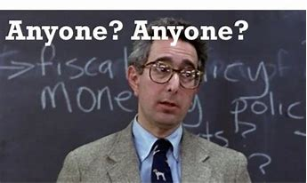
What questions do you have?
http://theind.com/article-20799-oil-crisis-is-anyone-guarding-his-assets-anyone-anyone-.html

Slide 29
Thank you!

Slide 30
References
Be a Health Literacy Hero [Image}. Retrieved from https://www.google.com/url?sa=i&rct=j&q=&esrc=s&source=images&cd=&cad=rja&uact=8&ved=2ahUKEwiSx9rxsLLeAhUh54MKHfGqBdQQjRx6BAgBEAU&url=http%3A%2F%2Fwww.everthriveil.org%2Fresources%2Fhealth-literacy-learning-collaborative&psig=AOvVaw2O5dlZSSEl3QTy22jd96JI&ust=1541132918817522
Federal Plain Language Guidelines. Plain Langague.gov. Accessed July 28, 2014.
Mary, K. A. (2012). The top ten reasons – Physicians are sued for medical malpractice. Legal Nurse Consulting – Issues, Ideas, Information. Retrieved from http://www.kmlegalnurse.com/consulting/the-top-ten-reasons-physicians-are-sued-for-medical-malpractice/
The Iowa Health System Health Literacy Collaborative. Teach-back: A Health Literacy Tool to Ensure Patient Understanding Presentation. www.nchealthliteracy.org/toolkit/tool5A.ppt ‎ (Accessed September 11, 2014).
Tip 6. Be Cautious About Using Readability Formulas. Content last reviewed May 2015. Agency for Healthcare Research and Quality, Rockville, MD. http://www.ahrq.gov/professionals/quality-patient-safety/talkingquality/resources/writing/tip6.html
Office of Disease Prevention and Health Promotion. 2020. Health Literacy in Healthy People 2030. https://health.gov/our-work/healthy-people/healthy-people-2030/health-literacy-healthy-people-2030 (Accessed June 14, 2021).
WisLit (2010). AMA Health Literacy Video: Short Version. Retrieved from https://www.youtube.com/watch?v=BgTuD7l7LG8
Writing for the Public. CDC Training. https://www.train.org/cdctrain/course/1066816. Accessed January 5, 2018.

